Slide 1
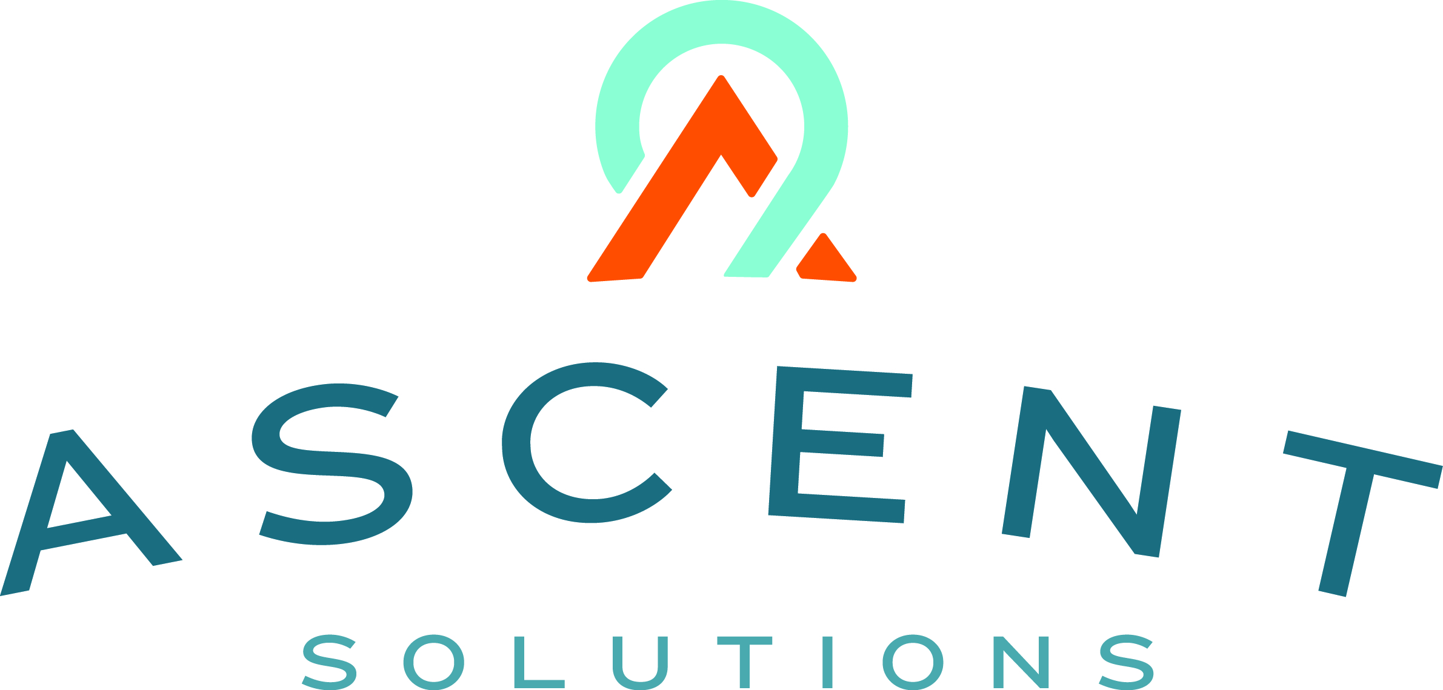
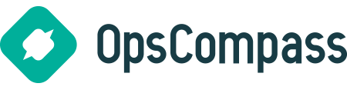
Content: aka.ms/omahadevdays
Survey: aka.ms/ncrdevdayssurvey
#Azuredevdays
Notes:
Keep it fun / demo heavy!

Slide 2
Azure DevOps Services
Dave Burnison
Technology Solutions Professional - Azure App Dev
Dave.Burnison@Microsoft.com
@DaveBurnison
http://aka.ms/DavesEventList

Slide 3


Slide 4
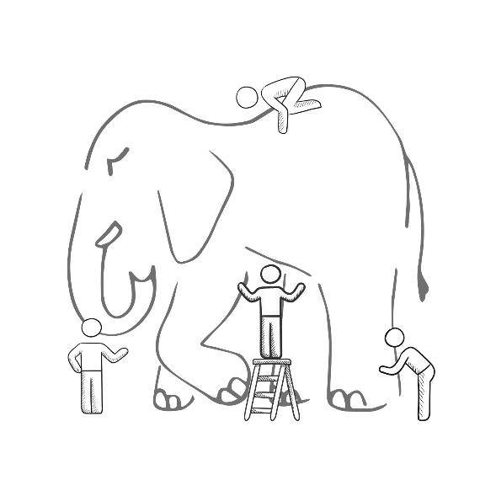
WHAT IS DEVOPS?
It’s a job title
It’s automation
It’s Development and Operations collaboration
It means faster and smaller releases

Slide 5

What is DevOps?
“DevOps is development and operations collaboration”
“DevOps is treating your infrastructure as code”
It’s DevOps!
It’s DevOps!
“DevOps is using automation”
It’s DevOps!
“DevOps is feature switches”
It’s DevOps!
“DevOps is small deployments”
“Kanban for Ops?”

Slide 6
What is DevOps?
People. Process. Products.
Build& Test
Deploy
DevOps is the union of people, process, and products to enable continuous delivery of value to your end users.
“
Continuous Delivery
Develop
Operate
”
Plan & Track
Monitor & Learn

Slide 7
What technologies do I need to support DevOps?
DevOps brings together people, processes, and products, automating software delivery to provide continuous value to your users. Using Azure DevOps, you can deliver software faster and more reliably - no matter how big your IT department or what tools you’re using.
Continuous integration (CI)
Improve software development quality and speed.
When you use Azure Pipeliens or Jenkins to build apps in the cloud and deploy to Azure, each time you commit code, it’s automatically built and tested and bugs are detected faster.
Continuous Deployment (CD)
By combining continuous integration and infrastructure as code (IaC), you’ll achieve identical deployments and the confidence to deploy to production at any time.
With continuous deployment, you can automate the entire process from code commit to production if your CI/CD tests are successful.
Continuous Learning & Monitoring
With Azure Application Insights you can identify how your applications are performing and test if the recent deployment made things better or worse.
Using CI/CD practices, paired with monitoring tools, you’ll be able to safely deliver features to your customers as soon as they’re ready.

Slide 8




Business Needs
Accelerate time-to-market while reducing costs
Drive innovation
Reach and engage

Slide 9
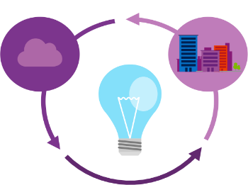
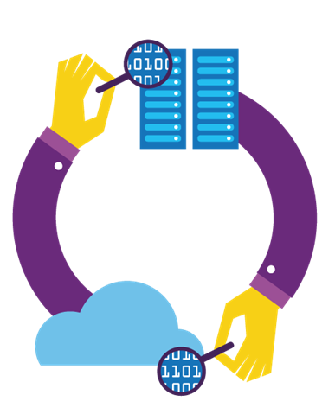
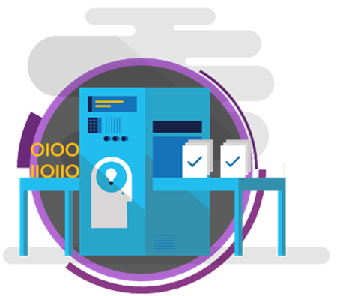
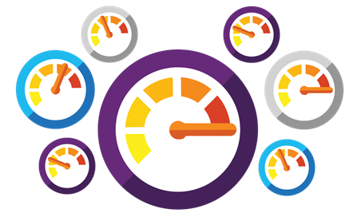
What needs to change to address those needs?
Shorten cycle times and deliver value faster
Improve quality and availability
Optimize resources and eliminate waste
Deliver innovation and great customer experience through experimentation

Slide 10
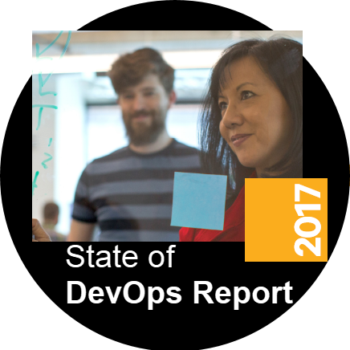
How DevOps impacts those needs?
Strong IT Performance is a competitive advantage
46x more frequent deployments
Firms with high-performing IT organizations were 2x as likely to exceed their profitability, market share, and productivity goals
and with 440x shorter lead time as compared to their lower-performing peers
DevOps Practices lead to higher IT performance
Recover 96x faster from failures
spend 21% less time on unplanned work and rework and 44% more time spent on new work
and have a 5x lower change failure rate as compared to their lower-performing peers
Source: 2017 State of DevOps Report presented by Puppet and DORA
Notes:
DORA – DevOps Research and Assessment https://devops-research.com/
Over the past six years (2013-2018) and more than 30,000 State of DevOps survey responses, we’ve found clear evidence that DevOps practices yield remarkable results for IT teams and organizations.

Slide 11


High Performance DevOps Companies Achieve…
46x Deployment
Frequency
2,555x Faster Lead
Time For Changes
Faster
Time to Market
DevOps
$
Increased
Revenue
7x Lower Change
Failure Rate
2,604x Faster Mean
Time to Recover
Source: 2018 Accelerate: State of DevOps: Strategies for a New Economy." N. Forsgren, J. Humble, G. Kim. DevOps Research and Assessment (DORA)
Notes:
Our analysis shows that high performers do significantly less manual work across all vectors, spend more time doing new work, and spend less time remediating security issues or defects than their low-performing counterparts. Because they build quality in, they spend less time fixing problems downstream, freeing up more time to do value-add work.
(Page 27).
High performers are twice as likely to exceed organizational performance goals as low performers: profitability, productivity, market share, number of customers.
(Page 24).
We’ve found that these benefits and results apply equally to all organizations, regardless of their industry vertical.
(Page 3).
Our analysis shows that any team in any industry, whether subject to a high degree of regulatory compliance or not—across all industry verticals—has the ability to achieve a high degree of software delivery performance.
(Page 11).

Slide 12
How Microsoft can help
Microsoft Azure is a powerful and flexible foundation for past, present, and future apps – easily build, manage, and deploy any application and any stack on a massive, global network using your favorite tools and frameworks.
Flexible
Powerful
Open
Choice of IaaS, PaaS, public cloud or hybrid.
Mirror or modernize app infrastructure with VMs, containers, microservices or serverless.
Supports all stages of the app modernization journey – from lift-and-shift to Cloud-Native.
Instantly improve the performance, scalability and resiliency of your apps by moving them to the cloud.
Increase business agility with Cloud-Native capabilities and built-in DevOps for continuous innovation.
Bring your stack, we bring a cloud that runs any app, on any platform, and any language.
Build applications using the language and tools of your choice - Azure supports what you already use and love so you can get up and running fast – just bring code.

Slide 13





Introducing Azure DevOps
Azure Boards
Azure Pipelines
Azure Repos
Deliver value to your users faster using proven agile tools to plan, track, and discuss work across your teams.
Build, test, and deploy with CI/CD that works with any language, platform, and cloud. Connect to GitHub or any other Git provider and deploy continuously.
Get unlimited, cloud-hosted private Git repos and collaborate to build better code with pull requests and advanced file management.
Azure Test Plans
Azure Artifacts
➔
Test and ship with confidence using manual and exploratory testing tools.
Create, host, and share packages with your team, and add artifacts to your CI/CD pipelines with a single click.
https://azure.com/devops

Slide 14
Azure DevOps
Better together
Azure Boards
Azure Repos
Azure Pipelines
Azure Test Plans
Azure Artifacts
An end-to-end solution for organizations looking for an enterprise-grade toolchain
Fully Integrated with end to end traceability
Scalable to any team and project size
Highly available, multi region, hybrid cloud & on-prem
Customer Support
Consistent admin and access control
➔
https://azure.com/devops

Slide 15



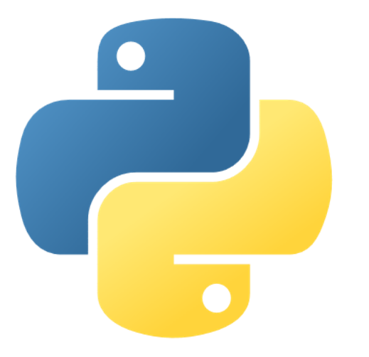
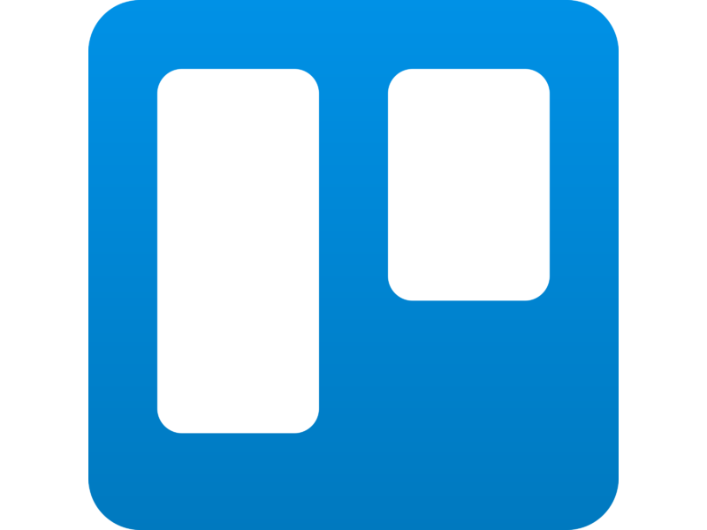


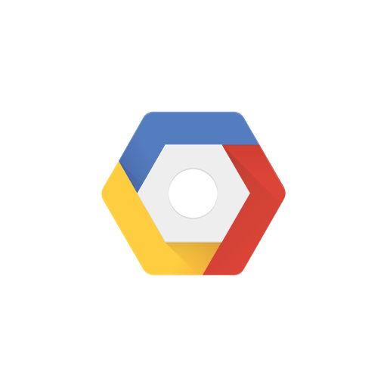

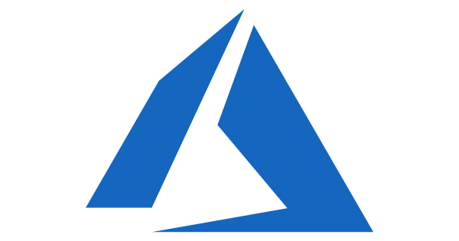


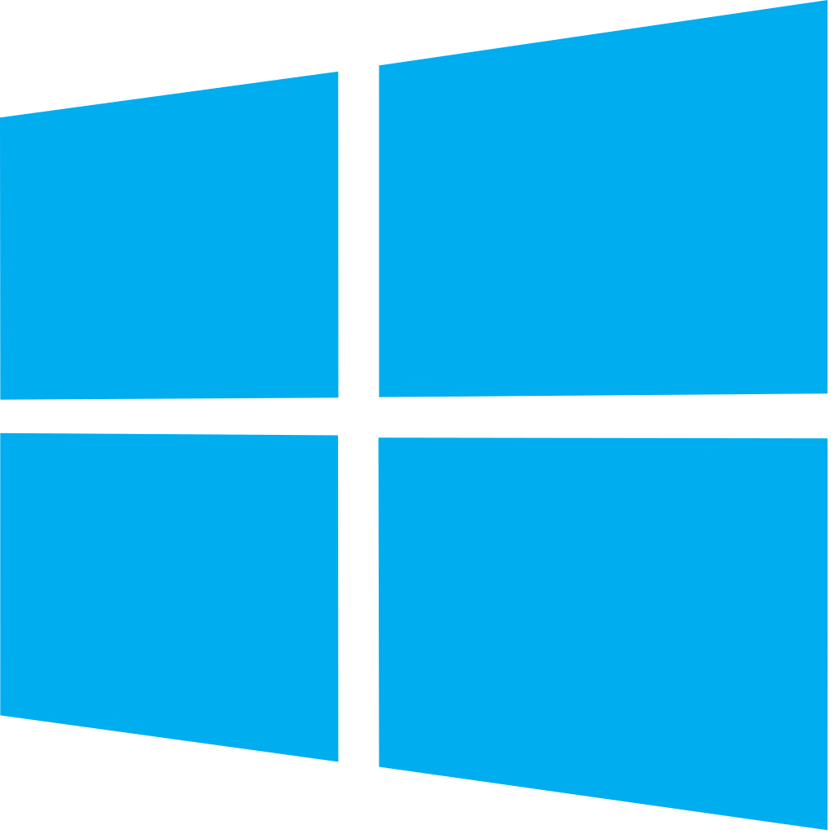


Azure DevOps: Choose what you love
Any Language, Any Platform
Azure DevOps lets developers choose the tools and languages that are right for them
Mix and match to create workflows with tools from Microsoft, open source or your favorite 3rd party tools
Target any cloud, on-prem or both and deploy to the servers you need

Slide 16
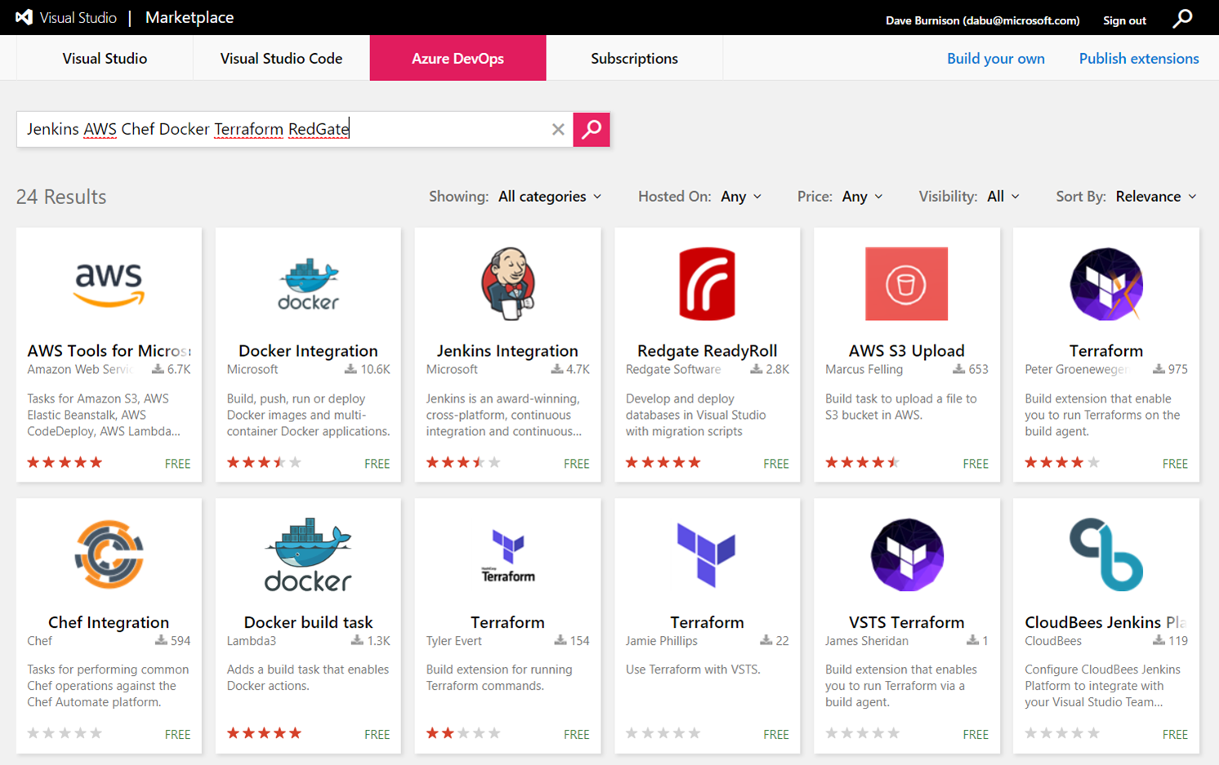
Get 3rd Party Extensions in the Azure DevOps Marketplace
https://marketplace.visualstudio.com/azuredevops
➔

Slide 17











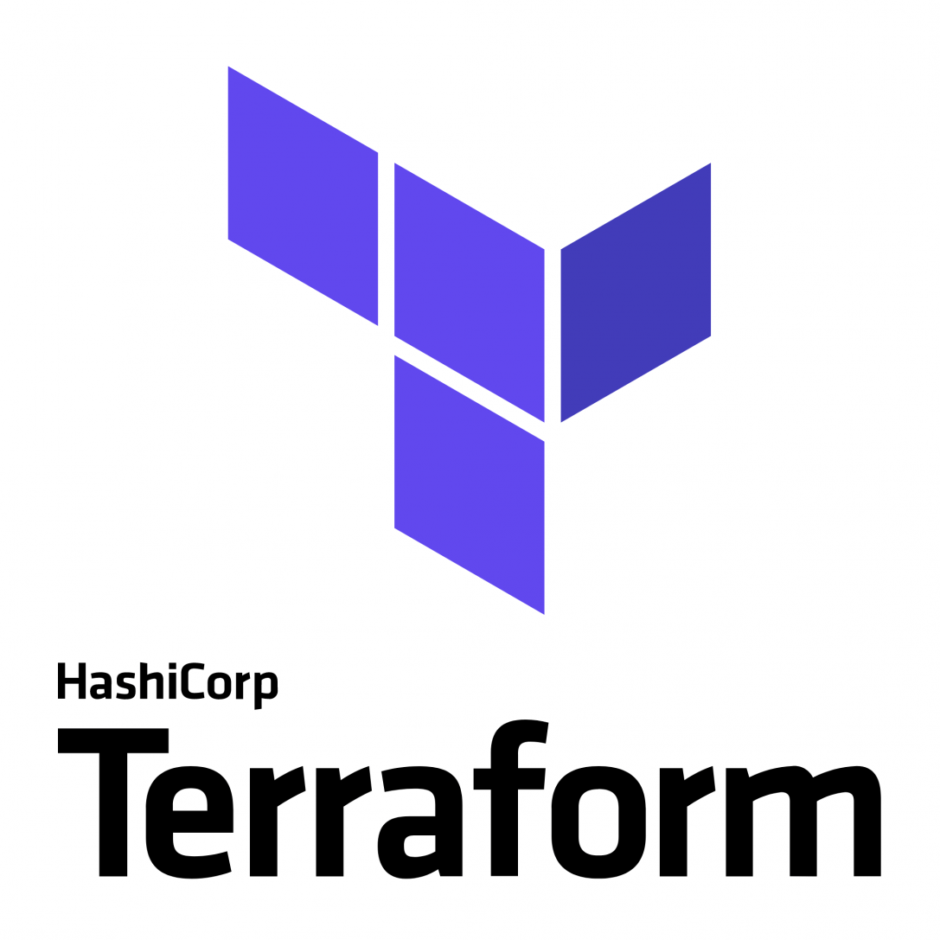





Broadening the Azure Ecosystem
Microsoft
Azure

Slide 18
Azure DevOps Services
Demo
Notes:
Demo : dev.azure.com

Slide 19

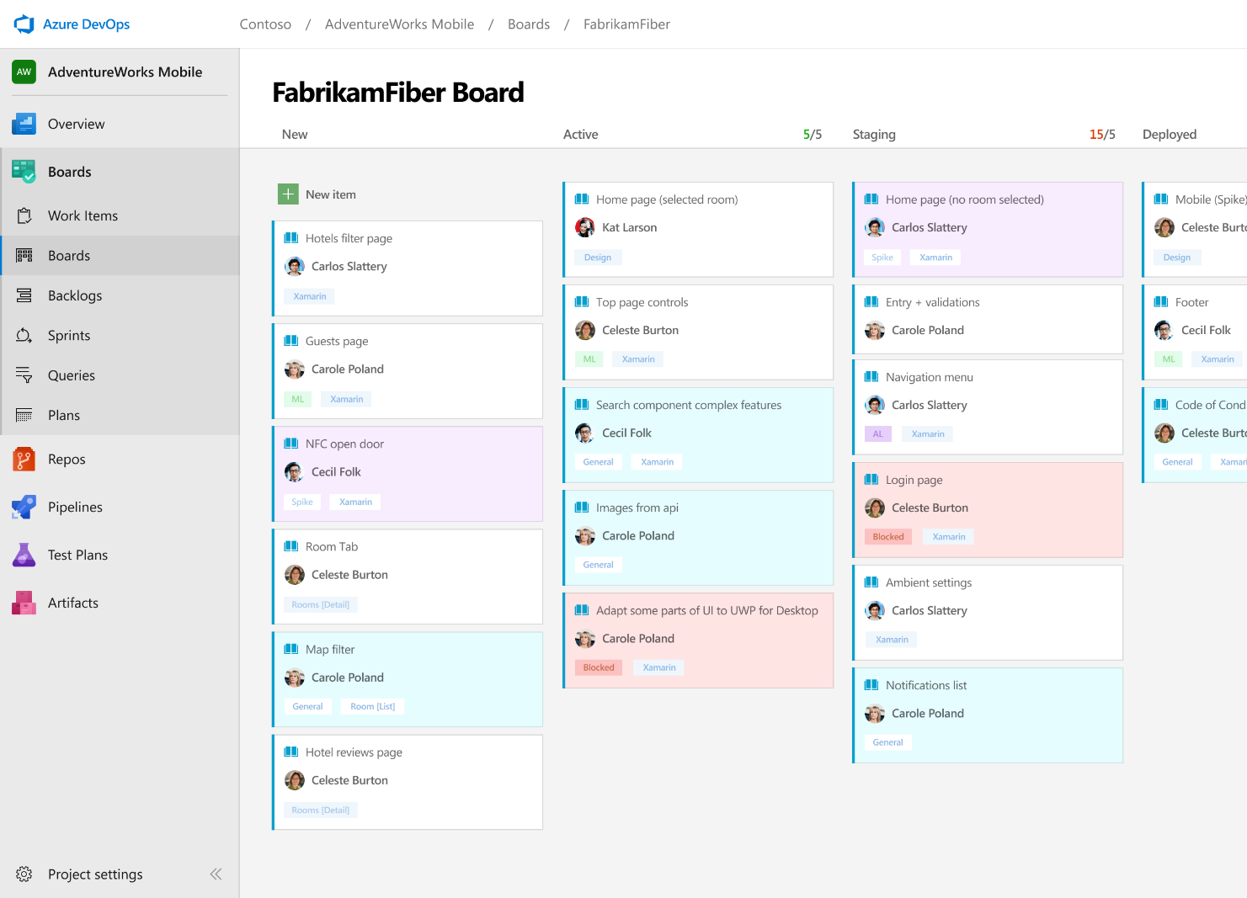



Azure Boards
Track work with Kanban boards, backlogs, team dashboards, and custom reporting
Connected from idea to release
Track all your ideas at every development stage and keep your team aligned with all code changes linked directly to work items.
Scrum ready
Use built-in scrum boards and planning tools to help your teams run sprints, stand-ups, and planning meetings.
Project insights
Gain new insights into the health and status of your project with powerful analytics tools and dashboard widgets.
➔
https://azure.com/devops

Slide 20
Azure Boards
Demo

Slide 21
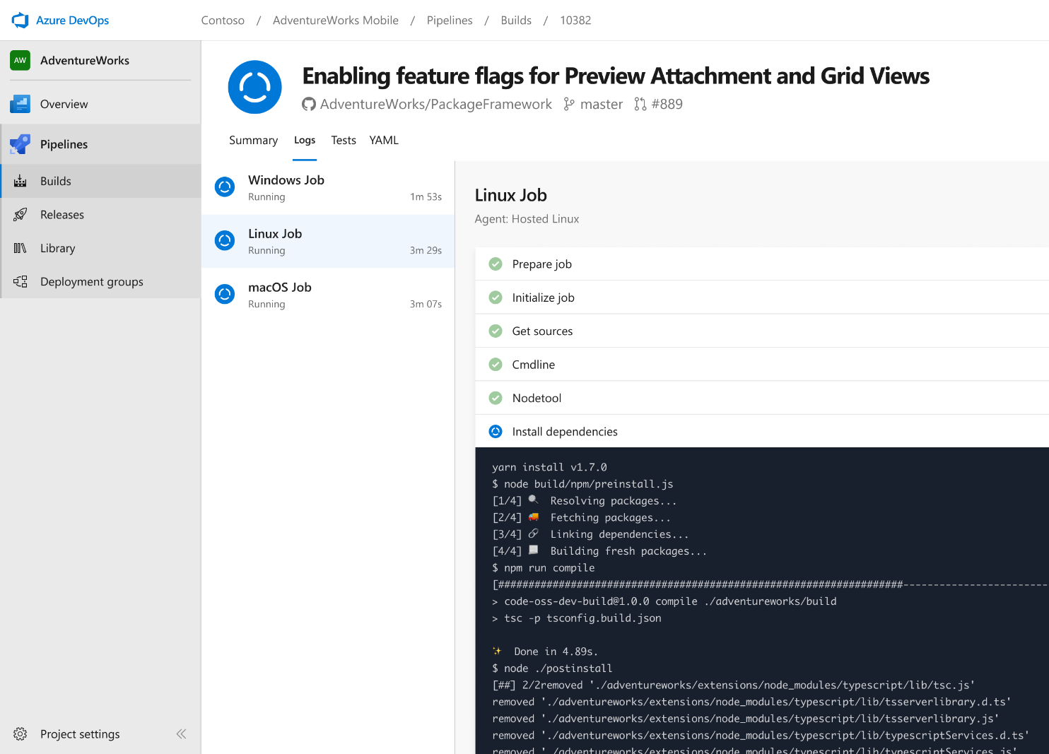


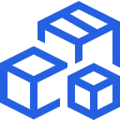
Azure Pipelines
Cloud-hosted pipelines for Linux, Windows and macOS.
Any language, any platform, any cloud
Build, test, and deploy Node.js, Python, Java, PHP, Ruby, C/C++, .NET, Android, and iOS apps. Run in parallel on Linux, macOS, and Windows. Deploy to Azure, AWS, GCP or on-premises
Extensible
Explore and implement a wide range of community-built build, test, and deployment tasks, along with hundreds of extensions from Slack to SonarCloud. Support for YAML, reporting and more
Containers and Kubernetes
Easily build and push images to container registries like Docker Hub and Azure Container Registry. Deploy containers to individual hosts or Kubernetes.
➔
https://azure.com/pipelines

Slide 22

Azure Pipelines
Cloud-hosted pipelines for Linux, Windows and macOS, with unlimited minutes for open source
Any language, any platform, any cloud
Build, test, and deploy Node.js, Python, Java, PHP, Ruby, C/C++, .NET, Android, and iOS apps. Run in parallel on Linux, macOS, and Windows. Deploy to Azure, AWS, GCP or on-premises
Extensible
Explore and implement a wide range of community-built build, test, and deployment tasks, along with hundreds of extensions from Slack to SonarCloud. Support for YAML, reporting and more
Containers and Kubernetes
Easily build and push images to container registries like Docker Hub and Azure Container Registry. Deploy containers to individual hosts or Kubernetes.
Best-in-class for open source
Ensure fast continuous integration/continuous delivery (CI/CD) pipelines for every open source project. Get unlimited build minutes for all open source projects with up to 10 free parallel jobs across Linux, macOS and Windows
➔
https://azure.com/pipelines

Slide 23
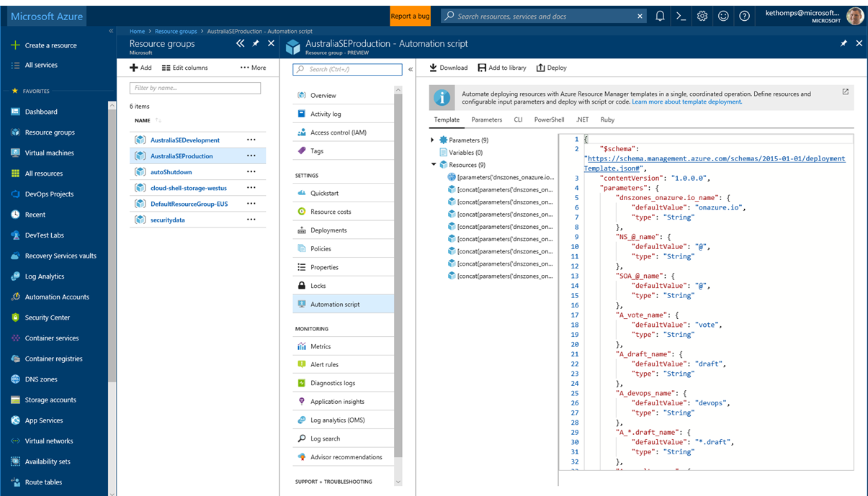
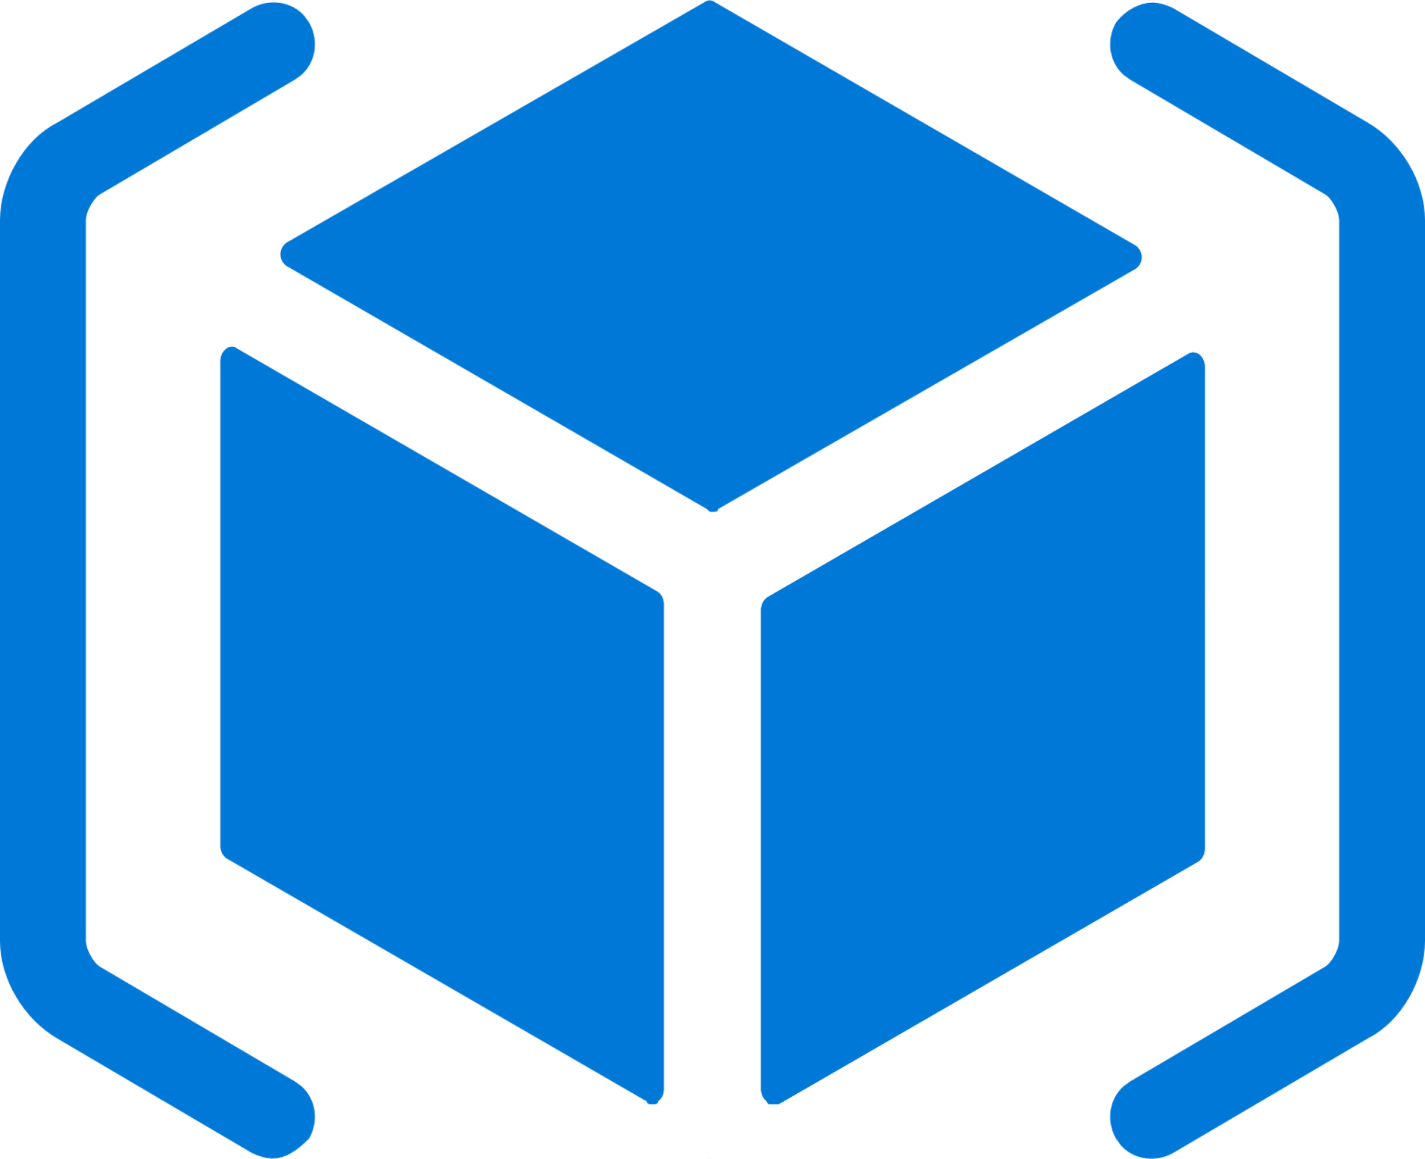


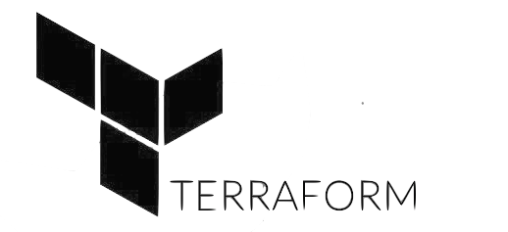
Deploy Repeatedly & Reliably
Azure Resource Manager & DevOps Tool Integrations
Infrastructure as Code, built-in with Azure Resource Manager
Use Azure Automation & Config to automate repetitive tasks
Support for DevOps tool integrations and OSS tooling such as Terraform, Ansible & Chef

Slide 24
Azure Pipelines
#AzureDevOps
Demo

Slide 25
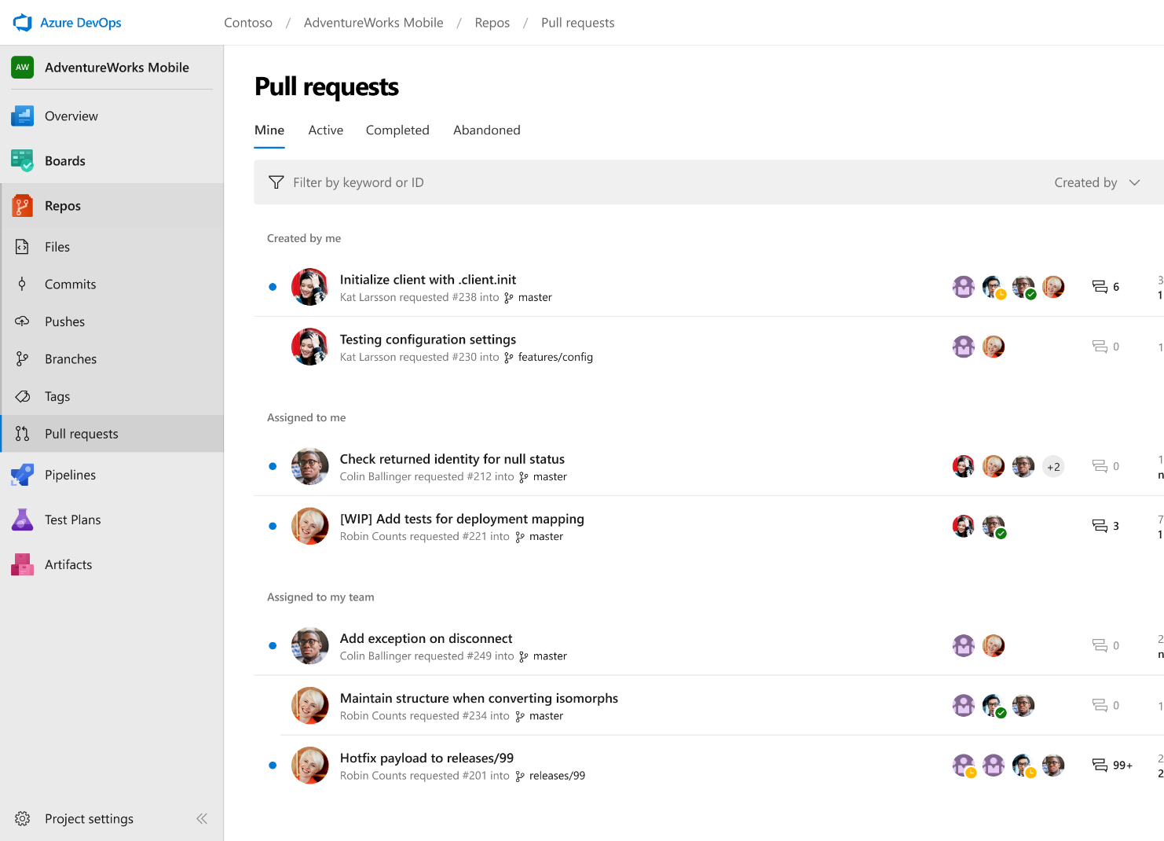



Azure Repos
Unlimited private Git repo hosting and support for TFVC that scales from a hobby project to the world’s largest Git repositories
Works with your Git client
Securely connect with and push code into your Git repos from any IDE, editor, or Git client.
Web hooks and API integration
Add validations and extensions from the marketplace or build your own using web hooks and REST APIs.
Semantic code search
Quickly find what you’re looking for with code-aware search that understands classes and variables.
➔
https://azure.com/devops

Slide 26
Azure Repos
#AzureDevOps
Demo

Slide 27
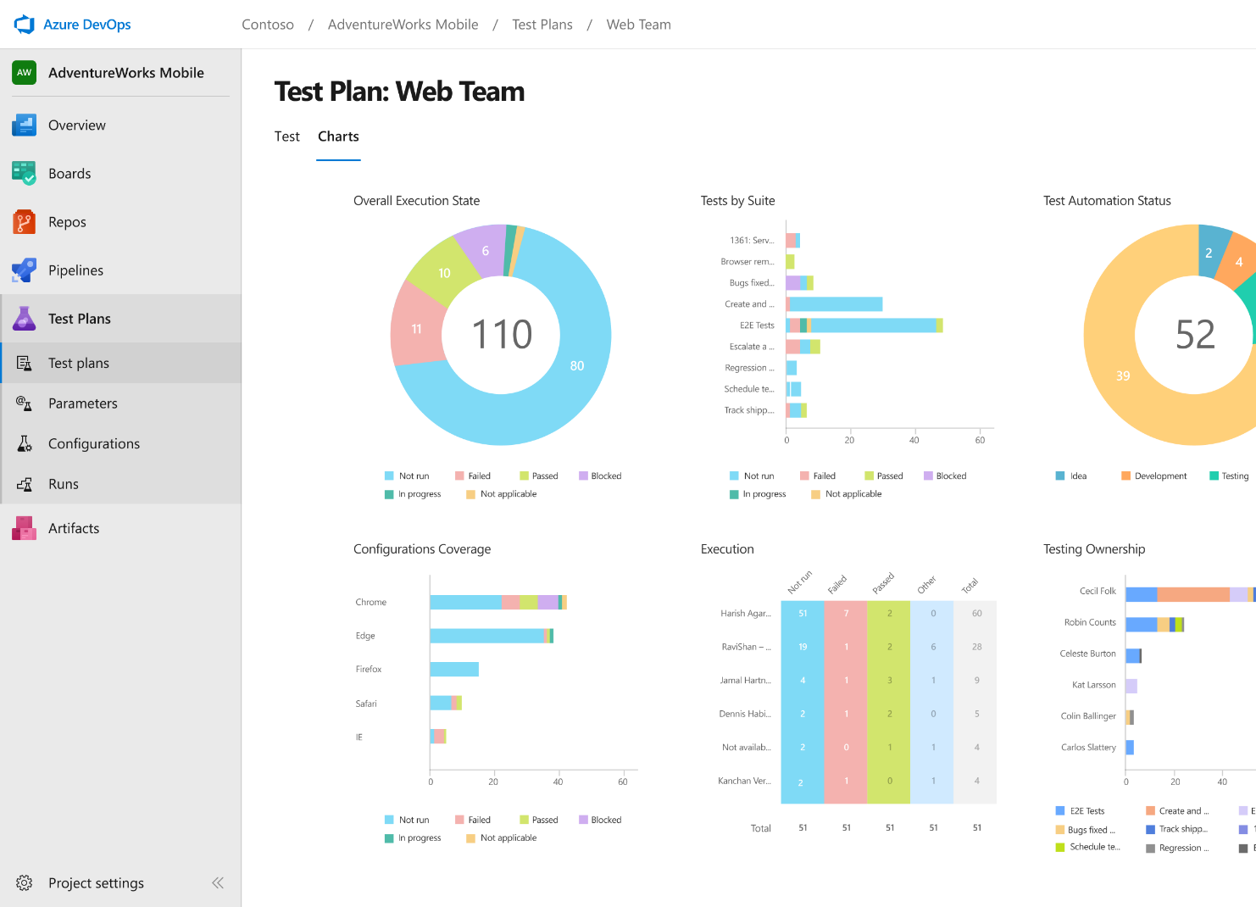
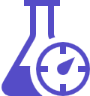


Azure Test Plans
Get end-to-end traceability. Run tests and log defects from your browser. Track and assess quality throughout your testing lifecycle.
Capture rich data
Capture rich scenario data as you execute tests to make discovered defects actionable. Explore user stories without test cases or test steps. You can create test cases directly from your exploratory test sessions.
Test across web and desktop
Test your application where it lives. Complete scripted tests across desktop or web scenarios. Test on-premises application from the cloud and vice-versa.
Get end-to-end traceability
Leverage the same test tools across your engineers and user acceptance testing stakeholders. Pay for the tools only when you need them.
➔
https://azure.com/devops

Slide 28
Azure Test Plans
#AzureDevOps
Demo

Slide 29
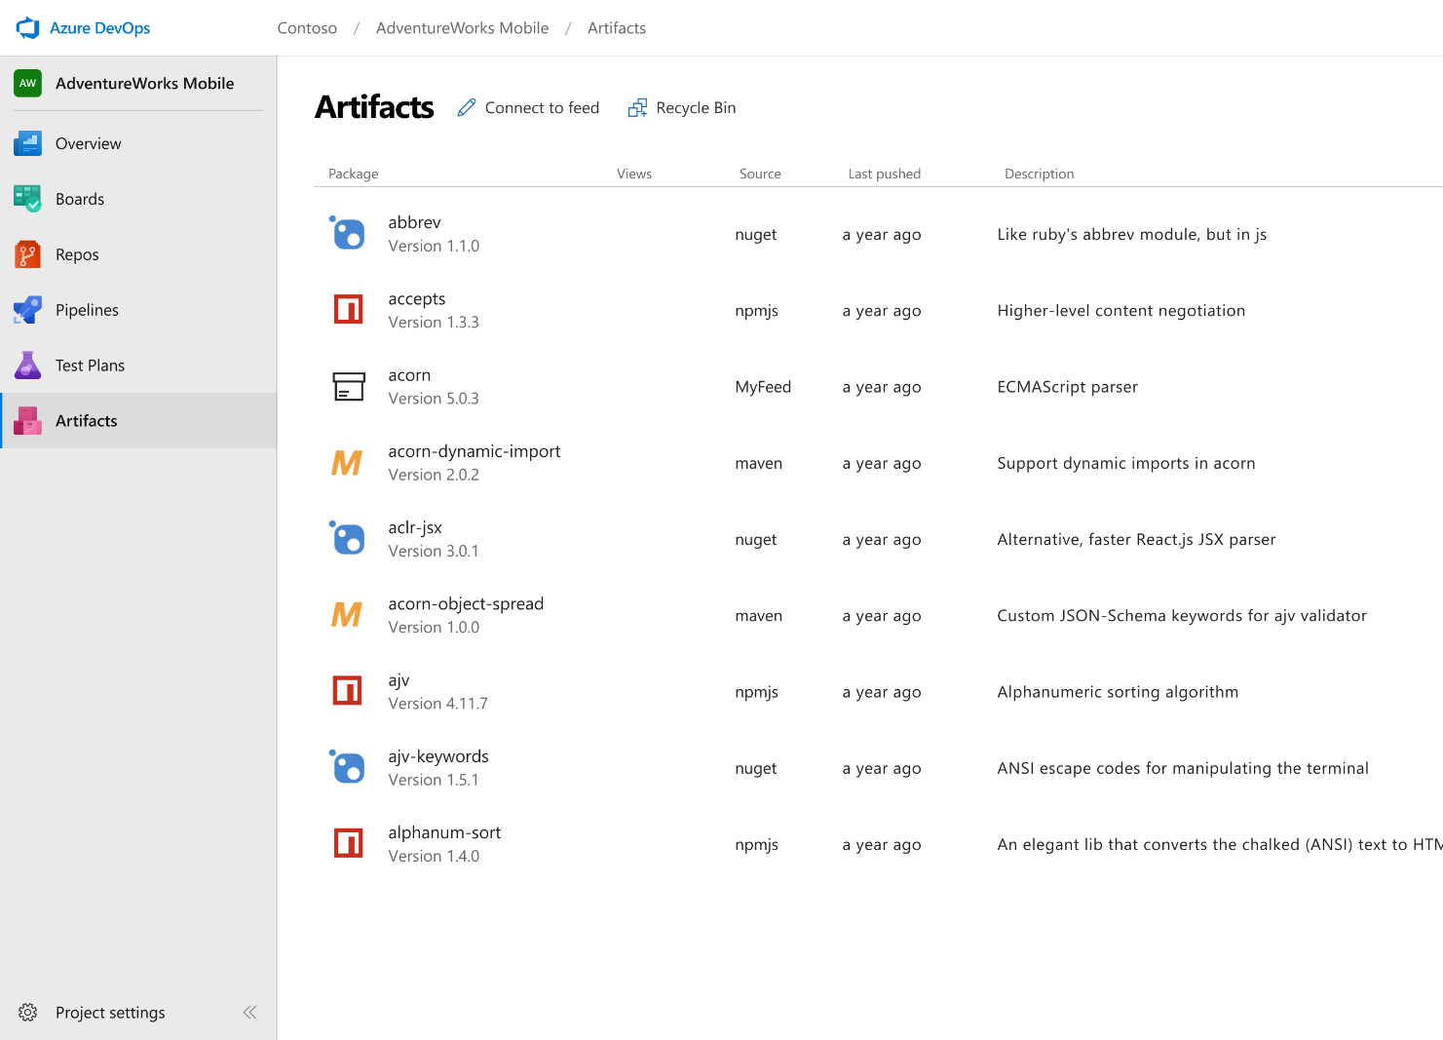



Azure Artifacts
Create and share Maven, npm, and NuGet package feeds from public and private sources – fully integrated into CI/CD pipelines
Manage all package types
Get universal artifact management for Maven, npm, and NuGet.
Add packages to any pipeline
Share packages, and use built-in CI/CD, versioning, and testing.
Share code efficiently
Easily share code across small teams and large enterprises.
➔
https://azure.com/devops

Slide 30
Azure Artifacts
#AzureDevOps
Demo
Notes:
Use the PartsUnlimitedArtifacts project: https://dev.azure.com/daveburnisonms/PartsUnlimitedArtifacts/_packaging?feed=PartsUnlimitedShared&_a=feed

Slide 31



Azure DevOps: Benefits of Using All Services
Ease of Use, Traceability
Leverage DevTest and Production Azure Subscriptions

Slide 32
Pulling it all together!
#AzureDevOps
Demo

Slide 33

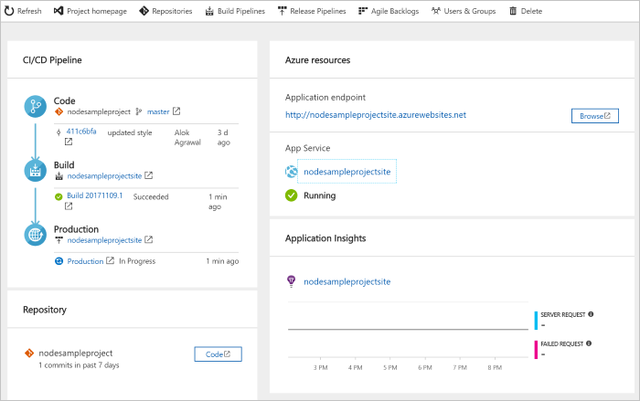
DevOps Pipelines in Minutes
Azure DevOps Projects
Create a full DevOps pipeline with 3 easy steps from the Azure Portal
Start with a Git repo and any source language
Web apps, Kubernates, soon VMs and more.
Customize, extend and scale when needed.
https://docs.microsoft.com/en-us/azure/devops-project/
➔
Notes:
Moving from the developer environment, Azure also makes deploying, or integrating existing, DevOps pipelines as fast as possible
Azure DevOps Projects is the quickest way to get started with DevOps on Azure for people who know about DevOps but are just starting or want a quick way to create a basic pipeline to play with or build upon.
DevOps projects creates a basic, complete CI/CD pipeline in Azure which can later be extended and customized outside in Azure Pipelines
Although DevOps Projects builds a DevOps pipeline on Azure it allows for any easy “Getting started” experience with Azure Pipelines which can then be applied to hybrid and on-prem scenarios with Azure Pipelines which can target any platform or with Azure DevOps Server which can be installed on prem.

Slide 34
Azure DevOps Projects
#AzureDevOps
Demo

Slide 35





Azure DevOps
Plan smarter, collaborate better, and ship faster with a set of modern dev services
Any developer, any platform, any cloud. Full support for hybrid cloud, on-premises & containers.
Use all the Azure DevOps services or choose just what you need to complement your existing workflows
Best in class builds for open source. Free unlimited build minutes for public projects and up to 10 free concurrent pipelines across Windows, Linux and macOS
Get started for free for small teams, scales to support the largest enterprises
Azure Boards
Azure Repos
Azure Pipelines
➔
https://azure.com/devops
Azure Test Plans
Azure Artifacts

Slide 36
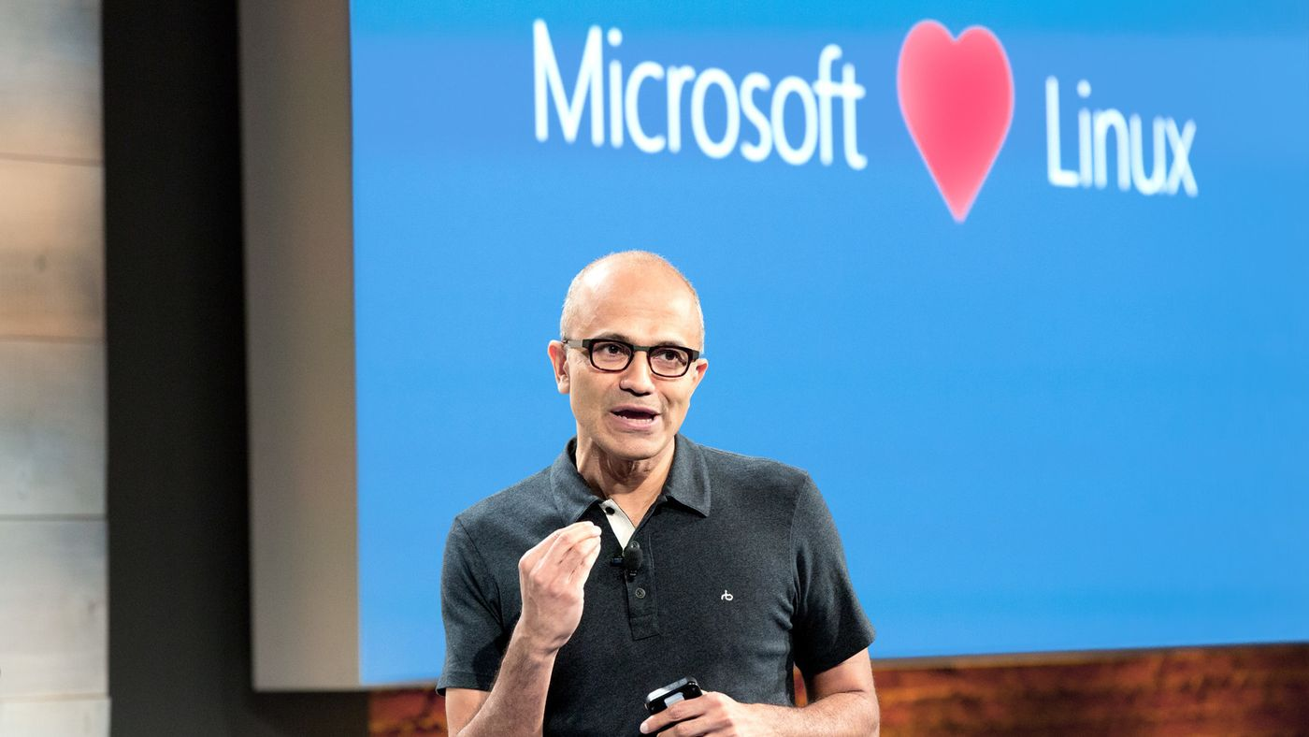
“Judge us by the actions we have taken in the recent past, our actions today and in the future”
—Satya Nadella, CEO Microsoft
2014
2018

Slide 37
Azure DevOps Services Pricing
Open Source Projects
Small Teams
Teams of any size
Free
Unlimited users and build time
Azure Pipelines: 10 parallel jobs with unlimited minutes for CI/CD
Azure Boards: Work item tracking and Kanban boards
Azure Repos: Unlimited public Git repos
Free
Start free with up to 5 users
Azure Pipelines: Run 1 Microsoft-hosted job for 1,800 minutes per month and 1 self-hosted job for any amount of time
Azure Boards: Work item tracking and Kanban boards
Azure Repos: Unlimited public Git repos
Azure Artifacts: package management
Unlimited stakeholders
Starts at $6 per user, per month for Boards & Repos*
Easy pricing that grows with your team
Azure Pipelines: Run 1 Microsoft-hosted job for 1,800 minutes per month and 1 self-hosted job for any amount of time
Azure Boards: Work item tracking and Kanban boards
Azure Repos: Unlimited public Git repos
Azure Artifacts: package management
Unlimited stakeholders
Boards & Repos included for Visual Studio subscribers
*
https://azure.microsoft.com/en-us/pricing/details/devops/azure-devops-services/
5 Boards & Repos users and 5 Artifacts users free. Pipelines with unlimited minutes, Test Plans users and additional Artifacts users also available. Please see the Azure pricing calculator for details.
➔

Slide 38
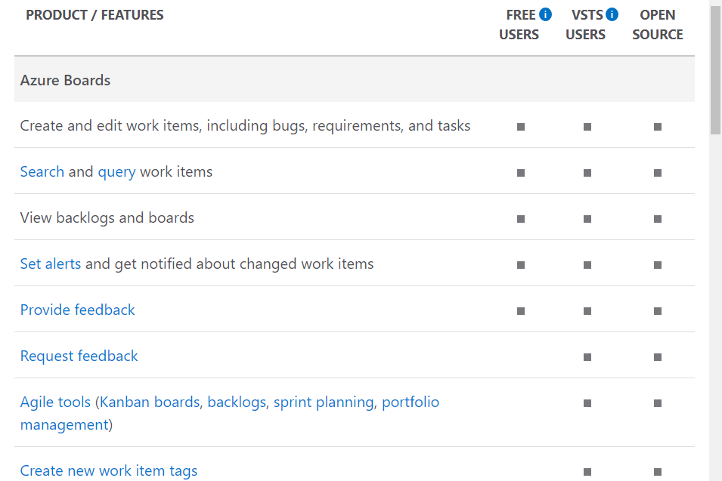
Compare Features Between Plans
https://azure.microsoft.com/en-us/services/devops/compare-features/
➔

Slide 39
Azure DevOps Services Benefits for Visual Studio Subscribers
Visual Studio Professional
Visual Studio Test Professional & MSDN Platforms
Visual Studio Enterprise
Basic Features
Basic Features
Test Manager
Basic Features
Test Manager
Artifacts (Package Management)
1 Concurrent Job of Self-Hosted CI/CD
https://docs.microsoft.com/en-us/visualstudio/subscriptions/vs-azure-devops
➔

Slide 40
Resources
Be passionate and bold. Always keep learning. You stop doing useful things if you don't learn.
- Satya Nadella

Slide 41
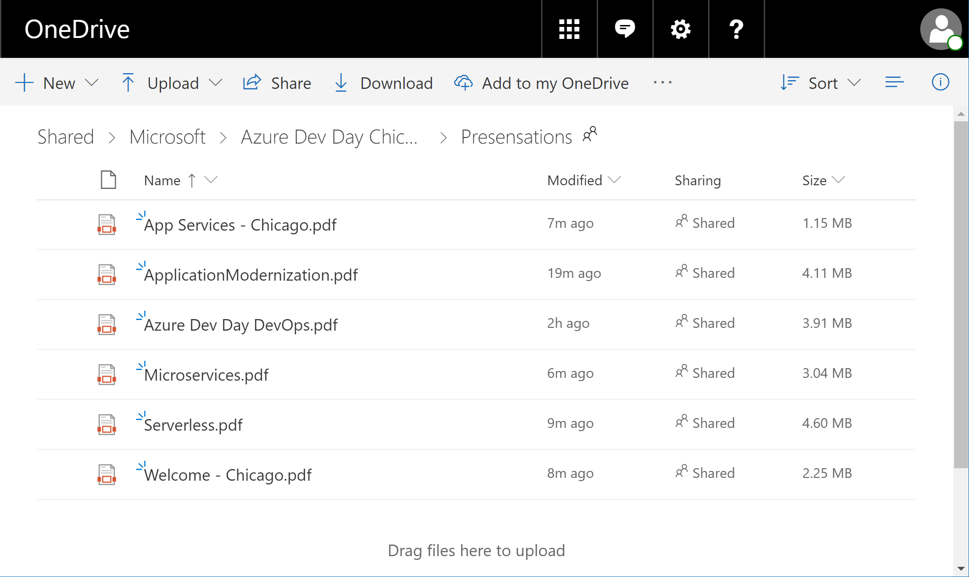
Get Today’s Presentations: http://aka.ms/AzureDevDayOmaha
http://aka.ms/AzureDevDayOmaha
➔

Slide 42
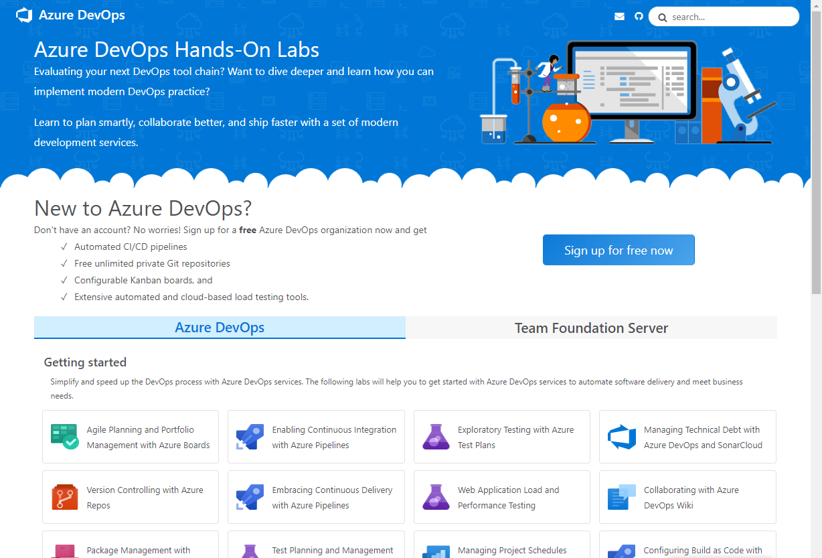
Get Hands On Experience with Azure DevOps
https://www.azuredevopslabs.com
➔

Slide 43
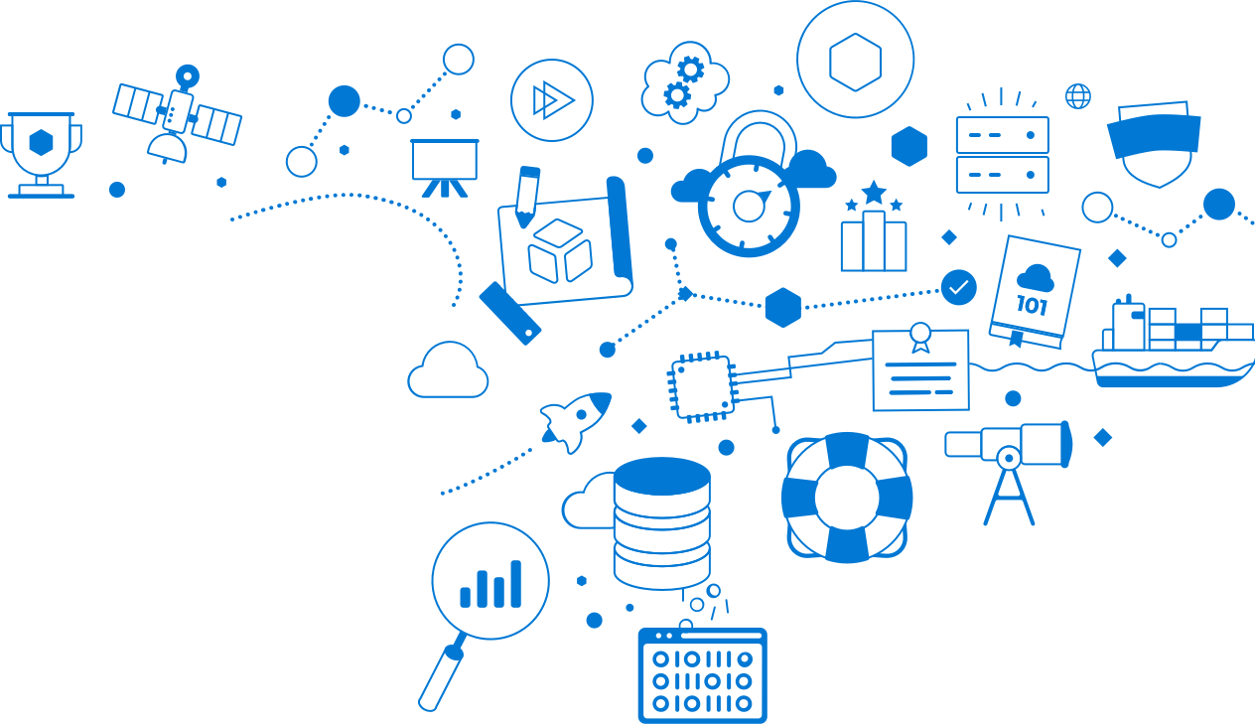
Microsoft Learn – Free!
New !
Build your skills fast with free, interactive tutorials at
Microsoft Learn, a new training experience for technical users.
Step-by-step training to fit your schedule
Interactive coding environments for hands-on experience
Earn achievements and recognition for your Azure skills
Start today at Microsoft.com/Learn
Notes:
pppIntroducing Microsoft Learn – the Best place to start learning Microsoft technologies – Free!
Quickly build skills: interactive, step-by-step bite-size tutorials
Learn by doing: browser-based interactive coding environments for hands-on experience. Free fixed-time access to create and manage Azure resources - no credit card required.
Earn recognition: Track progress, check knowledge, and validate deployments to earn points, levels, achievements, and trophies
Learning aligned to new role-based certifications: easier for you to prepare for certification and be recognized as a leader in Microsoft technologies
Multiple modes of learning: learn in way best for you. select from free self-paced quick tutorials and hands-on learning, to structured online courses free from Pluralsight and instructor led classes from learning partners.
Slide 2: animated learning Experience
This is just the beginning of our investment in building a learning experience to help our customers and partners build the skills in Microsoft technologies.
Today we have Over 60+ hours of learning content for Azure, Dynamics, and Power BI; and we will continue to building on this content and add additional Microsoft technologies to this experience
Visit our Microsoft Learn booth to experience our new learning platform and get insights from our experts on the best way to begin building Microsoft skills. Earn SWAG !
Visit microsoft.com/learn to begin building learning!
Background:
New role-based certifications!
Announcing new role-based certifications! Today we are releasing 3 new Azure role-based certifications her at Ignite:
Microsoft Certified Azure Administrator,
Microsoft Certified Azure Developer and
Microsoft Certified Azure Solutions Architect
Learning content across modalities including from Microsoft Learning Partners will align to the new role-based certifications to make it easier for you to prepare for certification and be recognized as a leader in Microsoft technologies

Slide 44
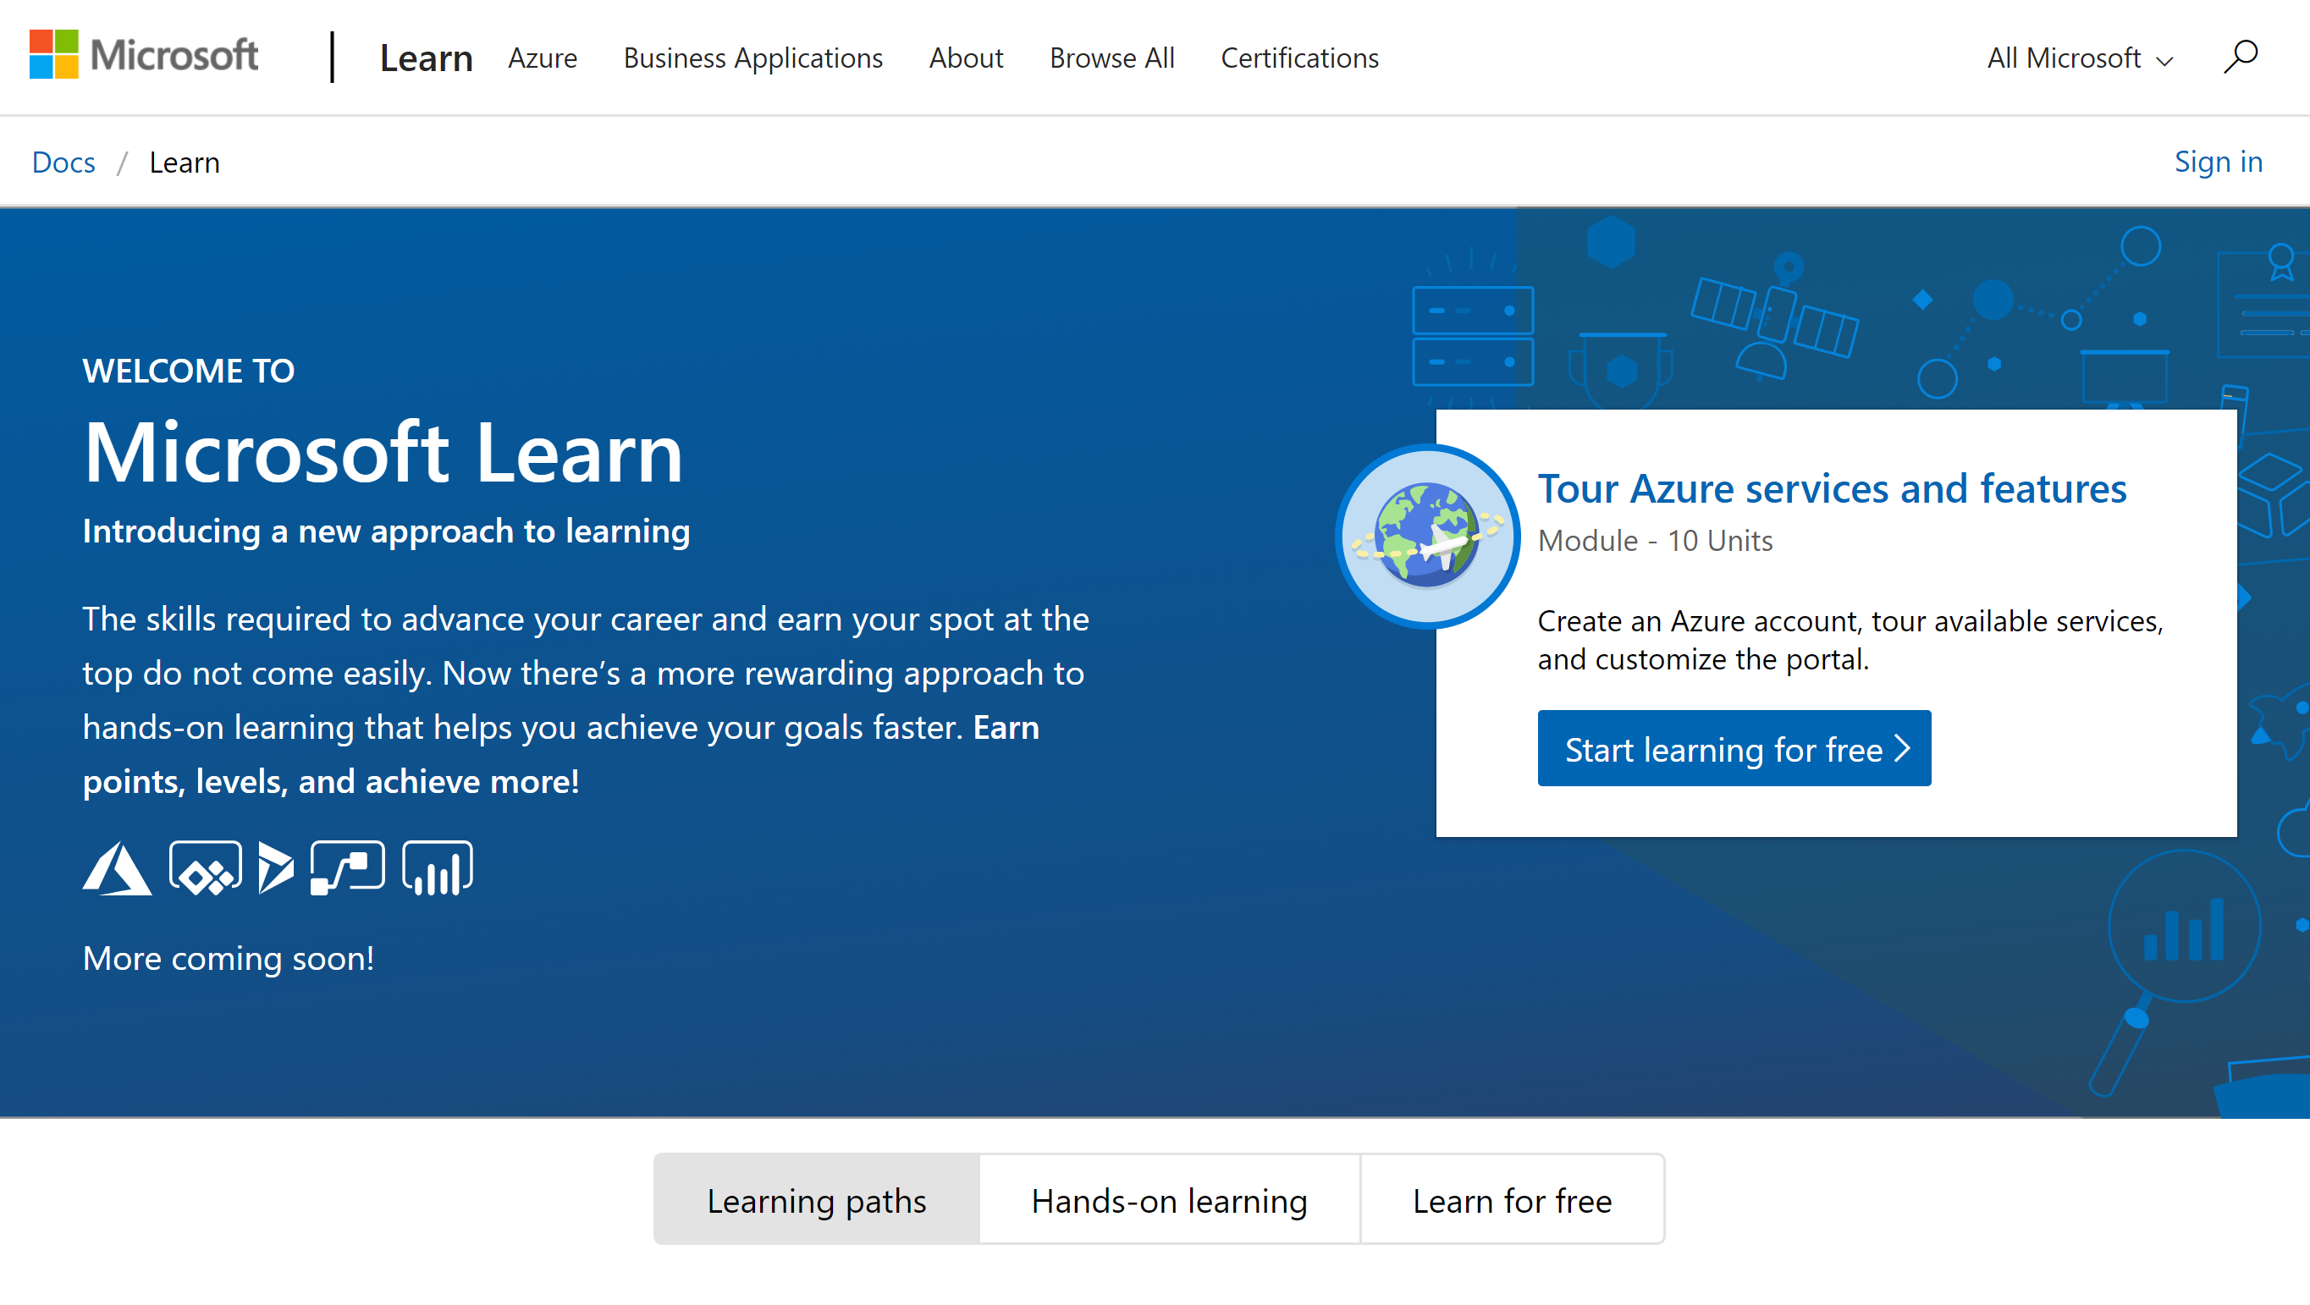
Get Hands On Experience with Azure
http://www.Microsoft.com/Learn
➔

Slide 45
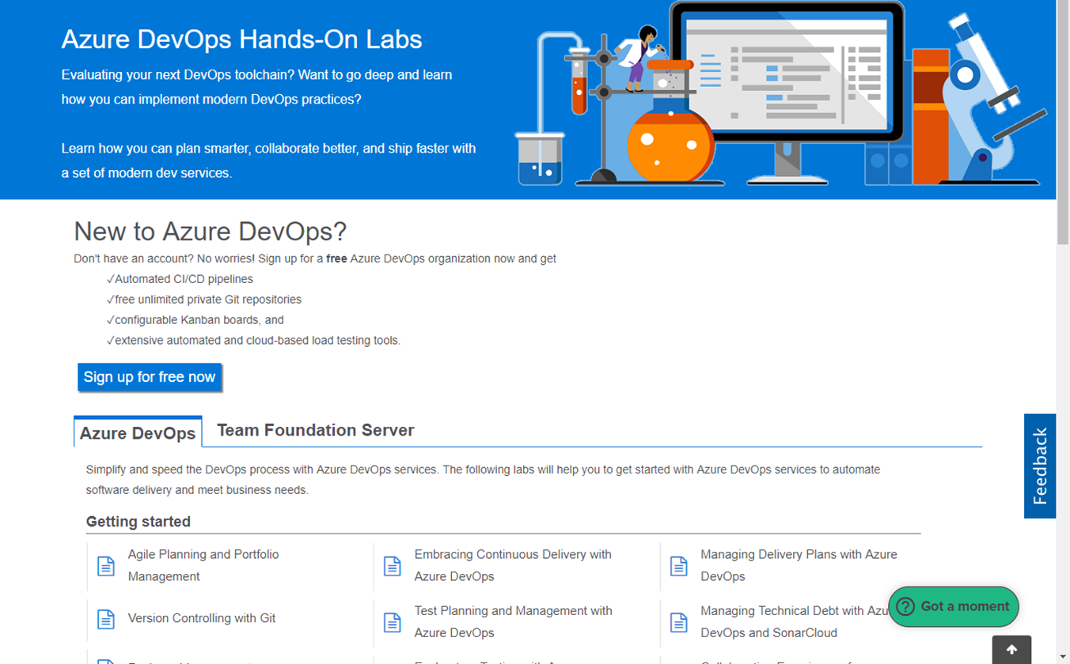
https://www.AzureDevOpsLabs.com
Getting started with Azure DevOps Services – Learn how you can plan better, code together and ship faster with Azure DevOps Services. To complete these labs use our Demo Generator to populate a Project in your Azure DevOps organization with the source code, work items, etc. needed to complete the labs. Once a lab is complete you can keep this Project around as a reference to use when applying the learnings to you team’s Azure DevOps organization.
Azure DevOps Integration with 3rd party tools - Azure DevOps provides integration with popular open source and third-party tools and services—across the entire DevOps workflow. Use the tools and languages you know. Spend less time integrating and more time delivering higher-quality software, faster.

Slide 46
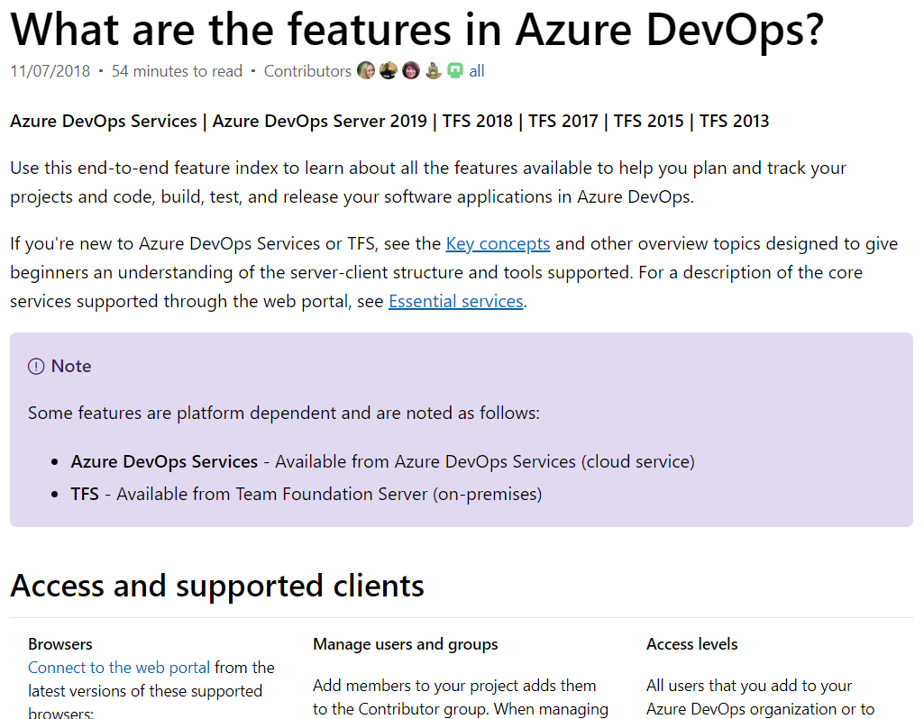
Azure DevOps Documentation
https://msdn.microsoft.com/library/ vs/alm/overview/alm-devops-feature-index
Use this end-to-end feature index to learn about all the features available to help you plan and track your projects and code, build, test, and release your software applications.
If you only save one Favorite in your browser related to Azure DevOps, this is the link to save as a favorite!
https://msdn.microsoft.com/library/vs/alm/overview/alm-devops-feature-index
➔

Slide 47
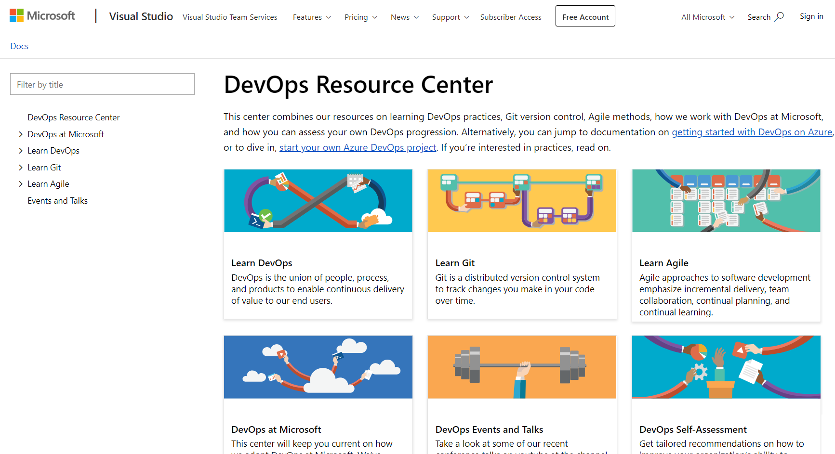
http://aka.ms/DevOps
Learn DevOps Concepts such as Agile, Git, CI/CD
Learn from Microsoft’s DevOps Journey

Slide 48




Azure DevOps supports small teams to largest enterprises
Instead of telling people to wait for 6 months for a new feature, we can give it to them in a few weeks…Our 2800 worldwide developers can use the same backlog, user stories and tests whether they’re on Windows or Linux… building for iOS or Android.
Speed is gained in moving to the PaaS offering of Azure DevOps. PaaS provides regularly released features and a future-proof capability, eliminating the need for Accenture to maintain infrastructure and go through upgrade cycles.
“
“
”
”
Microsoft made it really easy to break outside the silos… and tie the DevOps process into the fulfilment of business process. Without the tools that we have today, we would not be successful.
Branches sync 500 percent faster. Builds are 400 percent faster, with the typically six-hour process reduced to 90 minutes. We (now have) a highly streamlined process that operates with a few button clicks—and one-button deployment.
“
“
”
”
Notes:
https://customers.microsoft.com/en-us/search?sq=%22Azure%20DevOps%22&ff=&p=2&so=story_publish_date%20desc

Slide 49
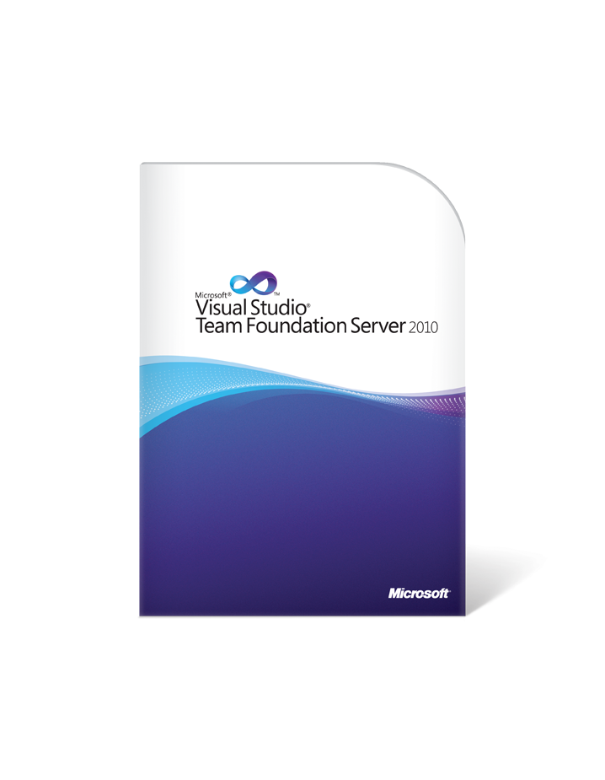
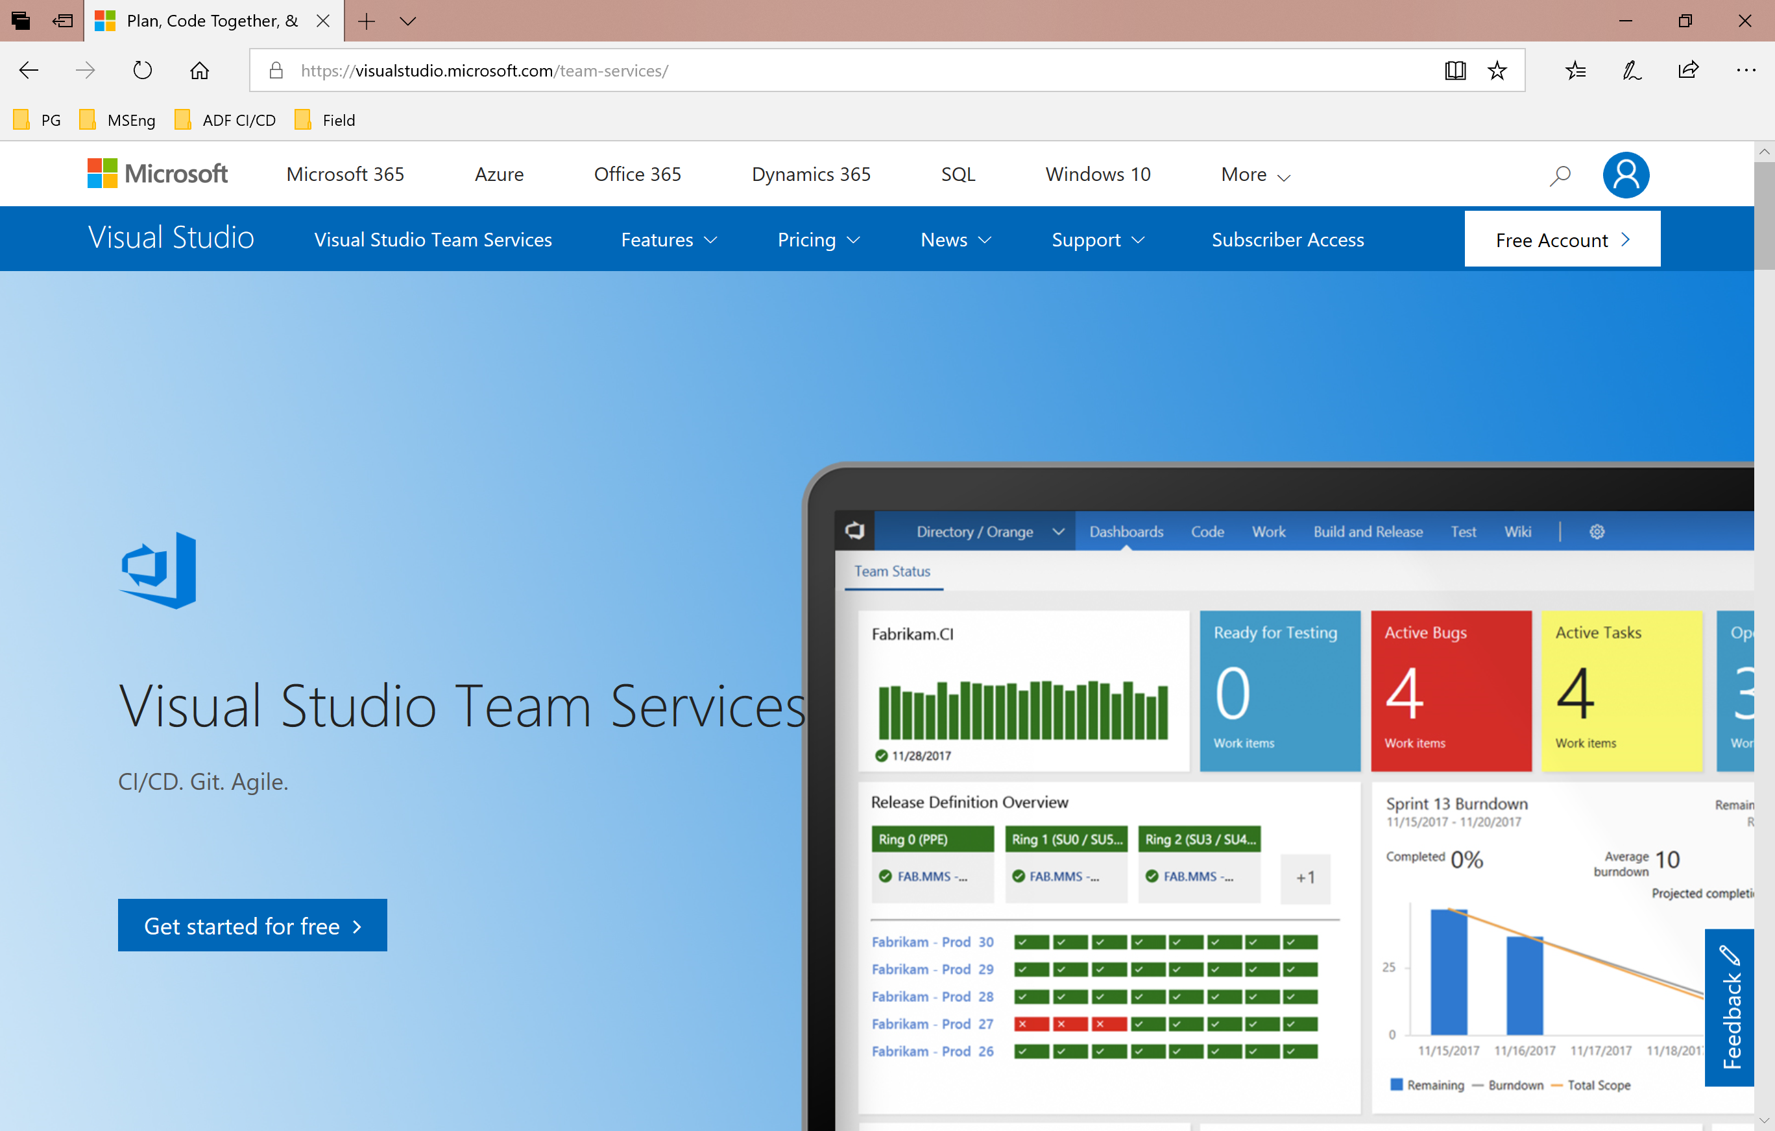
Lessons learned on our DevOps Journey
VSTS Preview
VSTS GA
1ES
Sprint 1
August 2010
Sprint 29
June 2012
Sprint 64
April 2014
Sprint 67
June 2014
Sprint 138
Jul 2018
Features delivered per year
➔
https://aka.ms/DevOpsLessonsLearned

Slide 50
DevOps in Microsoft
Azure DevOps is the toolchain of choice for Microsoft engineering with over 96,000 internal users
➔
https://aka.ms/DevOpsAtMicrosoft
372k
Pull Requests per month
4.4m
Builds per month
5m
Work items viewed per day
85,000
Deployments per day
2m
Git commits per month
500m Test executions per day
500k
Work items updated per day
Data: Internal Microsoft engineering system activity, November 2018
Notes:
And even today, not every single engineer in Microsoft has adopted common DevOps tools and processes. But we’re close in terms of tools adoption, and different products and teams have their own variants of common DevOps practices.
As of November 2018, our common DevOps platform has almost 96,000 ACTIVE users (engineers using the tools effectively every day)
That is in addition to the millions of users outside of Microsoft
We actually have a very large ongoing investment in the tools that we need to successfully do “DevOps” at Microsoft – approximately 800 team members define, build, support and evolve our DevOps platform…

Slide 51
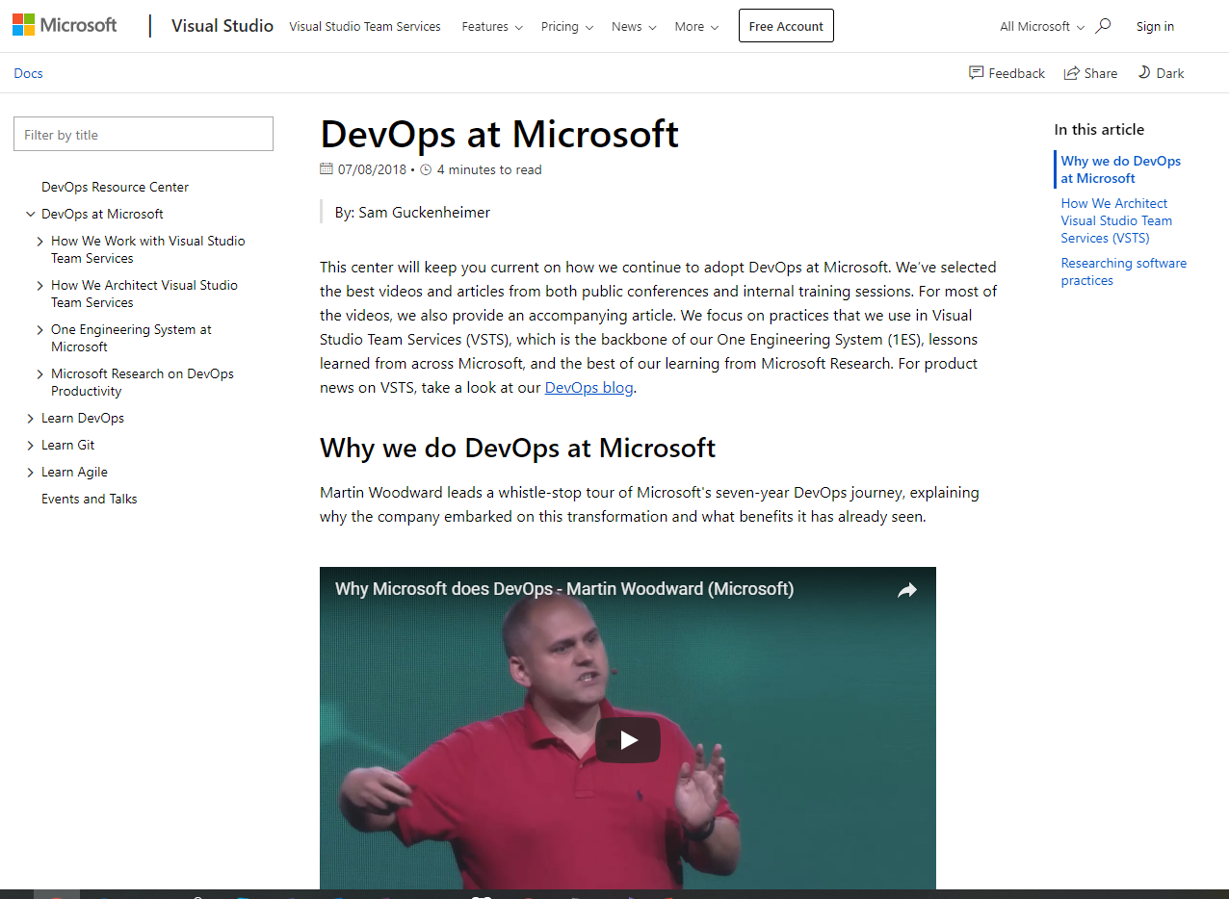
Share http://aka.ms/DevOpsAtMicrosoft with your team:
Create a series of “Lunch & Learn” sessions based on our DevOps journey. At each session watch one video and have a follow up discussion with your team.
Or, treat it like a book club, i.e. have everyone watch a video and read the related narrative as an assignment, then have a discussion session over lunch.
Either way, discuss with your team what is/is not applicable to your company, (or, what should be applicable in the future).

Slide 52
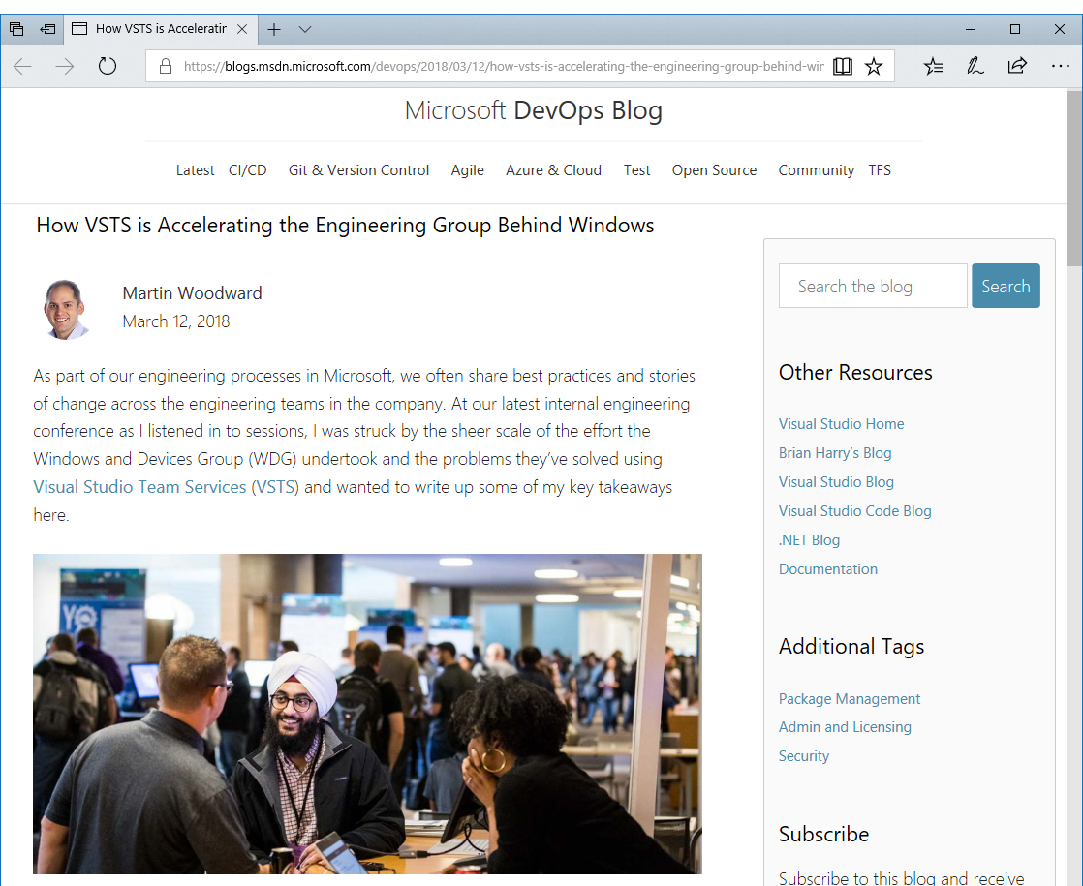
How VSTS is Accelerating the Engineering Group Behind Windows:
“With over 22,000 employees and 7,000 software developers in the group, it’s larger than many companies”
“The recent Fall Creators Update to Windows 10 consisted of around 4 million individual commits grouped into around 500,000 pull requests. All changes to the Windows code are reviewed via pull requests which has proven to be the best way to work in any Git team in Microsoft. It has taken significant engineering work to build a pull request system in VSTS that is able to handle pull requests at the scale of a group like WDG”
“WDG also puts a similar level of demand on the VSTS work tracking system. They currently have over 10 million work items tracking bugs, features and tasks etc”
“The WDG team has seen massive improvements in moving to VSTS, not just in pure throughput, but also in the satisfaction levels of engineers on the team. Engineer satisfaction is the one of the most important management metrics for WDG. This also reflects the change of culture not just in their group but also across Microsoft as a whole towards rewarding sharing and reuse”
“It’s been an incredible four years; we’ve come further than we could have imagined together through the power of DevOps and the benefits of encouraging a culture of sharing inside and outside the company.”

Slide 53
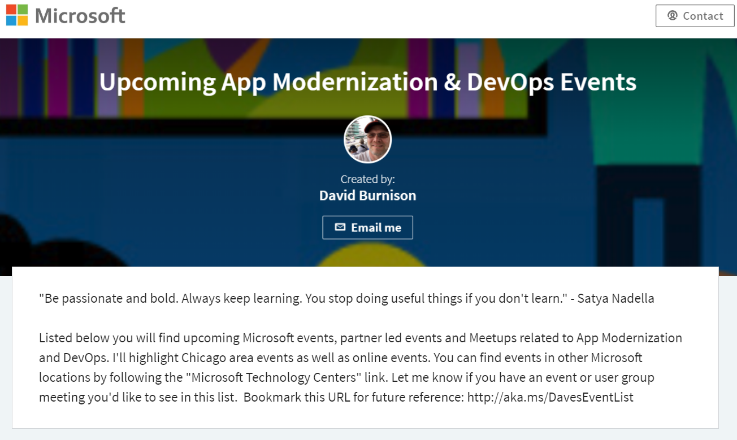
Find upcoming Microsoft events, partner led events, Meetups and online events related to App Modernization and DevOps. Check out http://aka.ms/DavesEventList

Slide 54
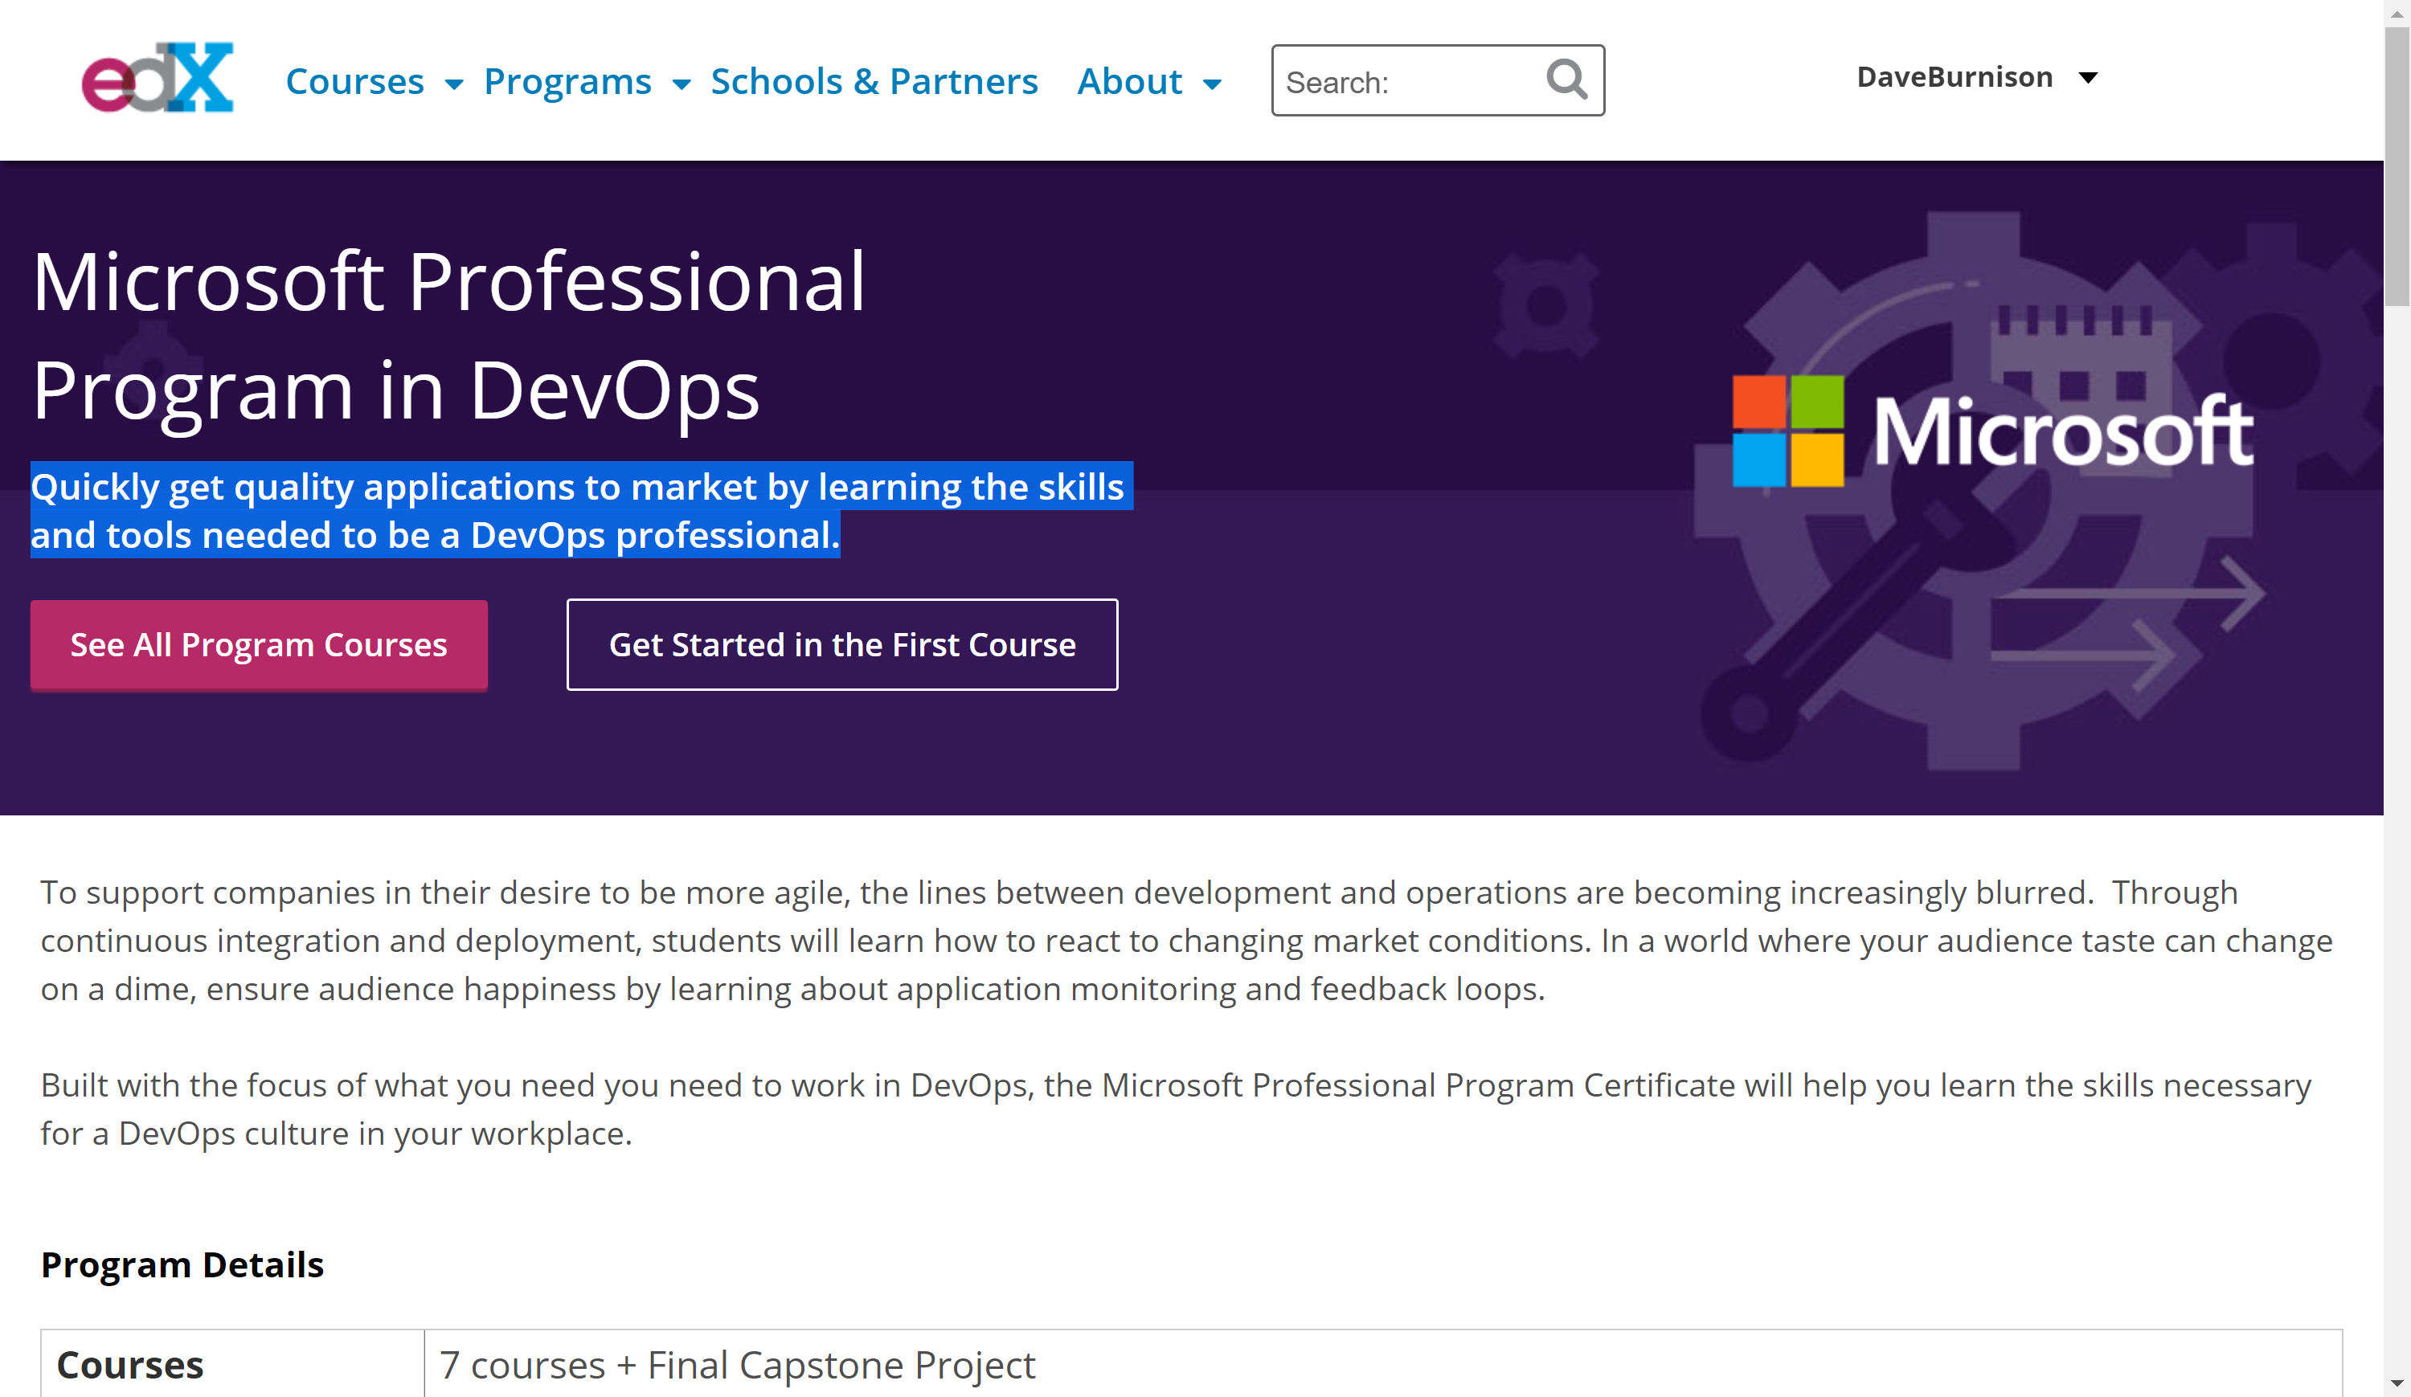
http://aka.ms/DevOpsCertification
Learn how to quickly get quality applications to market by learning the skills and tools needed to be a DevOps professional.
Audit the course or get your DevOps Certification

Slide 55
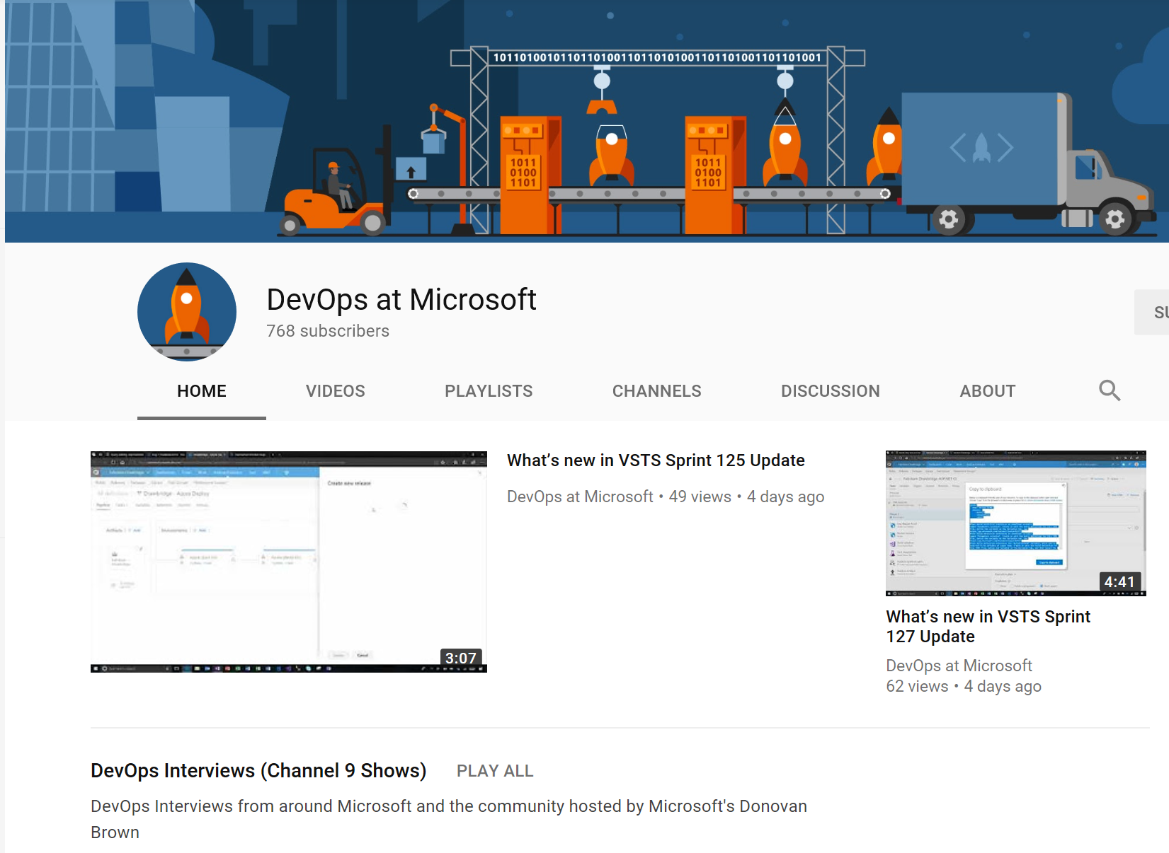
Subscribe to the ”DevOps at Microsoft” YouTube channel

Slide 56
Q&A

Slide 57

Questions?
Dave Burnison Dave.Burnison@Microsoft.com
@DaveBurnison
http://aka.ms/DavesEventList

Slide 58

Thank You!
Please fill out survey

Slide 59
